Slide 1
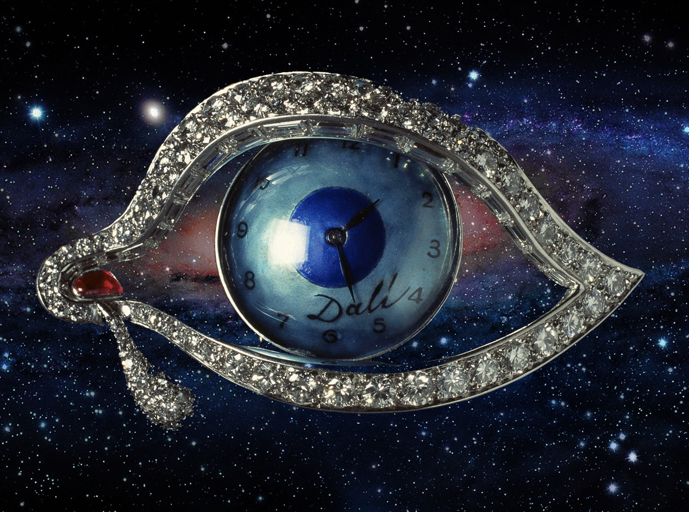
Photonic reformatting: Astrophotonic spectroscopy and Adaptive Optics
Illustration based on Time’s Eye by Salvador Dali © Salvador Dali, Fundacion Gala-Salvador Dali, VEGAP, Barcelona 2010
In regione caecorum rex est luscus (Desiderius Erasmus)
Jeremy Allington-Smith (Durham University)
with contributions by: Graham Murray, Rob Harris, Dave McLaughlan, Robert Thomson, Tim Birks, Itan Gris Sanchez, Tim Morris, Alistair Basden, Eric Gendron

Slide 2
Why Florence?
Galileo Galilei buried here (S. Croce)
Medici family’s motto:
Home of the Risorgimento
Will Astrophotonics tread the same path?
κοσμος κοσμου κοσμος

Slide 3
Contents of this talk
Why Integrated Photonic Spectroscopy is good….
… but not always: There are no free lunches
Focus on high resolution
Photonic reformatting with Adaptive Optics
(See talks by Roger Haynes, Robert Thomson, Itan Gris Sanchez)
Are…. but first, a word about FRD

Slide 4
FRD and thermodynamics
Etendue not conserved -> information is lost
OR requires more money

Slide 5
Integrated Photonic spectroscopy
IN PRINCIPLE
Significant advantages especially for ELT cosmology
Miniaturisation -> mini-spectrograph ideal for ELT cosmology
No optics, highly integrated device with simple geometry
Mass production by laser inscription for multiplexed applications
Also: elimination of modal noise?
Application to high-precision spectroscopy?

Slide 6
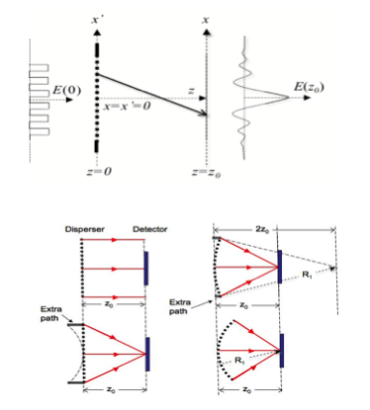
Integrated Photonic Spectrograph
See papers by Bland-Hawthorn, Czetojevic, Lawrence et al.
See Roger Haynes’s talk
Waveguide
array
Input
waveguides
Freespace Propagation Zone
Output
waveguides
Based on Arrayed Waveguide Gratings (AWG) used extensively in telecommunications
Analagous to traditional bulk disperser
Highly integrated, no optics
Replace output waveguides with 1-D detector
Replace input waveguides with reformatted slits
Requires single-mode input

Slide 7
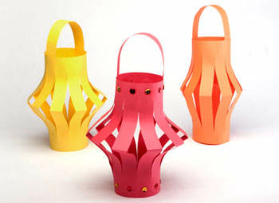
Conversion to single modes
Core with high refractive index
Substrate with low refractive index
Multimode
Many single modes
One thick waveguide
supporting N modes
Transition zone
N thin waveguides, each supporting 1 mode
See Leon-Saval, Bland-Hawthorn, Czetovic, Lawrence, Haynes et al.
MMW
IMW
SMW

Slide 8
Electric field MMW
Using slab model:
Colours indicate
Different modes

Slide 9
Electric field IMW
Same scale

Slide 10
Electric field SMW
Same scale

Slide 11
Modal evolution
Many non-degenerate modes
Core
Single degenerate mode in each output
Effective refractive index
MMW
Outer diameter
SMW
Substrate

Slide 12
Wave model
e.g. Snyder, A. W. and Love, J. D., [Optical Waveguide Theory], Chapman and Hall Ltd. (1983).
Maxwell’s equations
Wave equation
Helmholtz equation
Geometry+ boundaries
Unified dispersion relation
Weak guiding
Helmholtz equation for core and cladding
Field distribution in core
Field distribution in cladding

Slide 13
More realistic case (2D)
2-D geometry using multicore fibre (Leon-Saval et al. OpEx 18, 8430 (2010))
Degenerate supermode
SM
MM

Slide 14
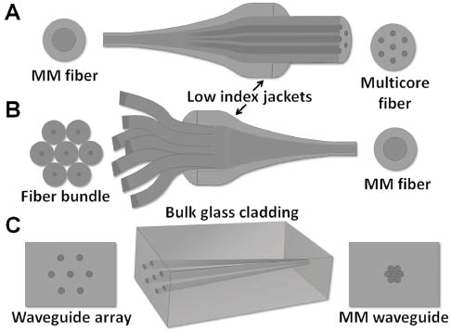
Other ways
See e.g.
Noordegraaf et al. OpEx 17, 1988 (2009); OpEx 18, 4673 (2010)
Leon-Saval et al. Opt Lett 30, 2545 (2005)
Jovanovic OpEx 20, 15 (2012)
Birks et al. OpEx 20, 13996-4008 (2012).
Thomson, Kar, and Allington-Smith, OpEx 17, 1963-1969 (2009).
Courtesy of Birks et al.

Slide 15
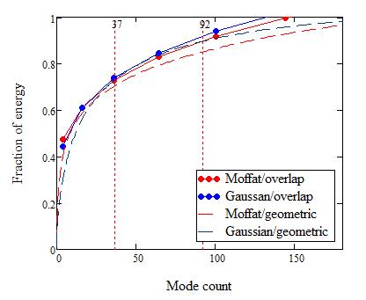
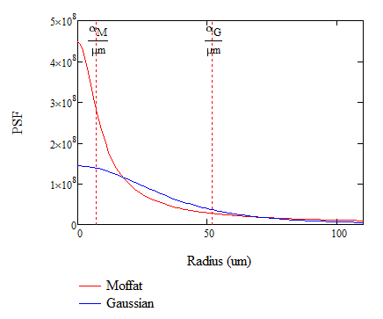
Fractional energy vs mode count
Example calculation for 50μm FWHM
Calculated using overlap integral between waveguide and propagating mode
Moffat has very extended wings as Gaussian but same FWHM

Slide 16
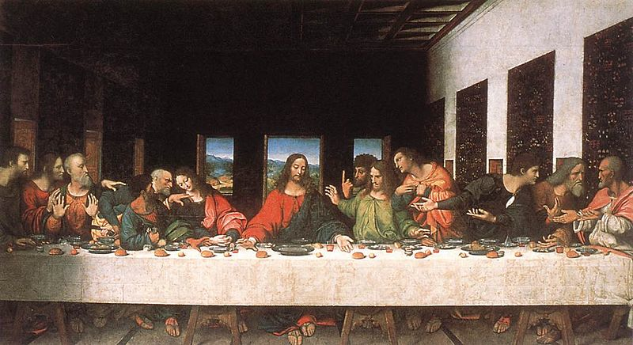
No free lunch
There is no such thing as a free lunch. Anon. in response to Henry Wallace, US vice-president, 1943)
Who ordered the 5000 anchovies?
So we need 12 copies of the reciept?
But I didn’t have a starter

Slide 17
No free lunch 1
Input focus
Reformatter
/switcher
Slit Spectrograph
2D Detector
Celestial light is Multimoded (aperture >> diffraction-limit)
Each mode to be dispersed separately
Alternately, can use multiple-input AWG and cross-disperse but bulky
ispersedField
Longslit
Diverse
field
Field
Traditional
Multiple
object
Field
Single
object
To first order IPS is as large as traditional instrument
Focus on applications where mode count small – near to diffraction limit
Astrophotonic
Field
Multiple
object
Photonic lantern
AWGs
1D detectors

Slide 18
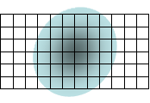
Image slicing: optimised spectroscopy
Maximise throughput x spectral resolution or integral field spectroscopy
Slicing
(N)
Example has N=3
1 spectrograph with N slices
N spectrographs with 1 slice each

Slide 19
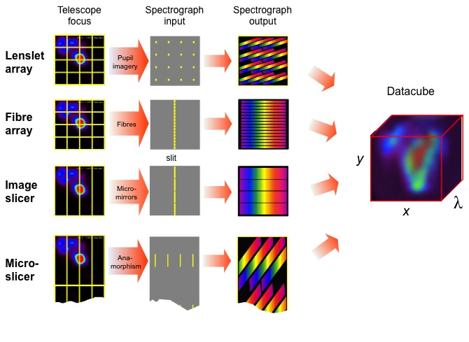
Image slicing/dicing technology

Slide 20
Image slicing: reduce disperser size
Important for ELTs
f_{S}
D_{S}
x
Disperser
z
y(λ)
Collimator
z
This example for double-pass Littrow echelle grating with N=2
Twice the slit length
Half the disperser size
Half the slit width
Or double number of spectrographs

Slide 21
Reformatting slit (dicing)
Segment field, reformat into slit
If image resolved -> spatially-resolved-spectroscopy with optimal throughput and tradeoff between spatial resolution and spectral resolution
If image unresolved (e.g. poor seeing) -> optimises spectral resolution x throughput
Advantage:
increased throughput
Improved spectral and/or spatial resolution
Disadvantage:
Needs extra detector pixels -> more noise, cost
Complex optics, reduced throughput

Slide 22
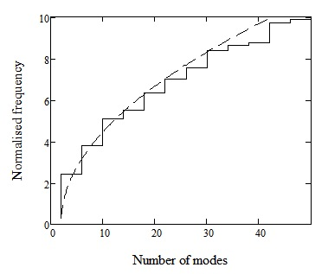
No free lunch 2
Θ =Limiting numerical aperture
FT = focal ratio of collimator
Number of modes
In cylindrical waveguide
of diameter d_{F}
Area of fibre core
Area of each diffraction-limited subset
Number of diffaction-limited subsets
(size d_{D}) Into which field is split
Number of modes required = number of diffraction-limited pieces

Slide 23
MNRAS 428, 3139 (2013)

Slide 24
Calculation of IPS sizes
Relative scale lengths
For normal applications, is as big as traditional instruments
Number of detector pixels very large
Number of detector pixels
Semi-photonic instruments
Reference instrument

Slide 25
Reducing the number of modes

Slide 26
Reduced-mode applications
Use with Adaptive Optics - natural option
Currently prototyping photonic reformatter to form idealised narrow slit for high precision spectroscopy -> See Robert Thomson’s talk
Complementary to other work on photonic spectroscopy (Sydney, Potsdam..)
Additional incentive: Use photonic reformatter as a Wavefront Sensor?

Slide 27
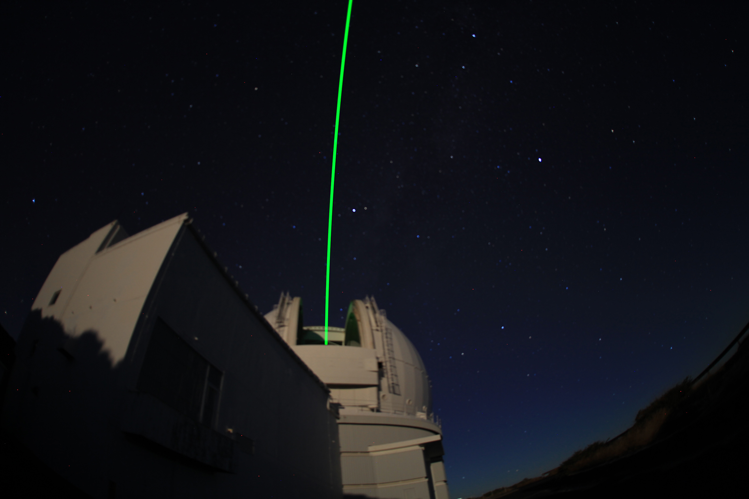
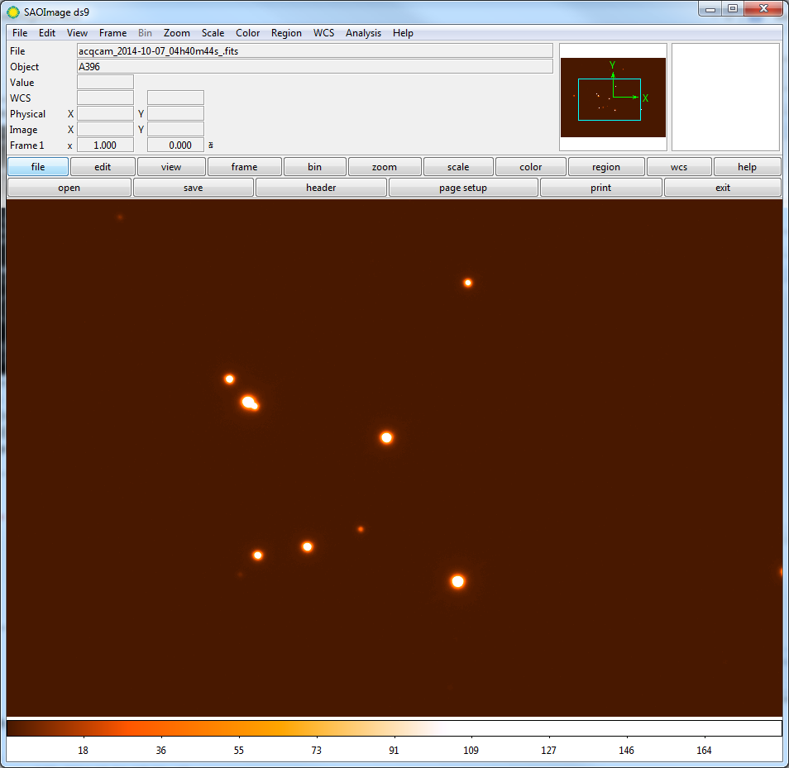
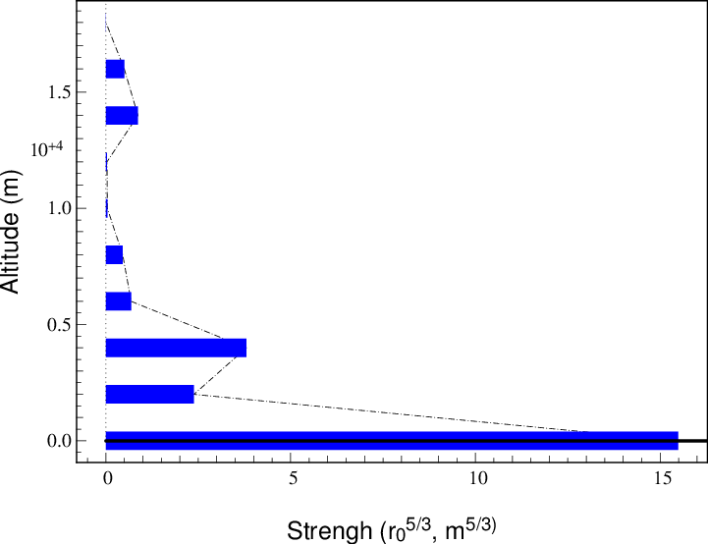
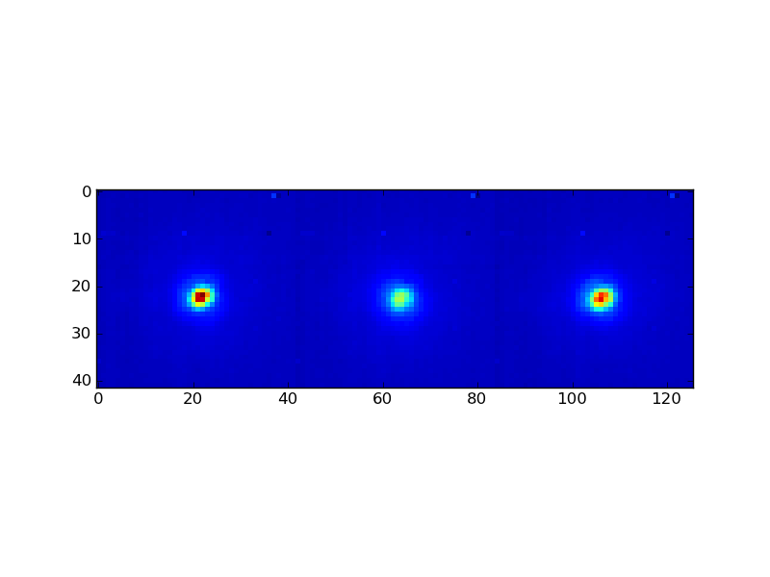
Adaptive Optics: Canary
LTAO = Laser Tomograohy
GLAO = Ground-layer
SCAO = Single-Conjugate
Adaptive Optics testbed for ELT on WHT (Durham/Paris)
M_{V}= 11.43
Turbulence Profile @ 06h30m UT 07/10/2014
50”
39”
M_{V}= 10.62
24”
α=06 48 17.3, δ=+41 04 59
45”
M_{V}= 8.86
Recent results (Oct 2014)
Laser altitude 14km
Several flavours of LTAO investigated
3 tip-tilt only NGS and 4 high-order LGS
3 high-order NGS and 4 high-order LGS
3 high-order NGS only
All compared to SCAO using ‘truth’ WFS
LTAO: First ever on-sky demonstration
SCAO
GLAO (4L3T)
LTAO (4L3T)
Strehl: 27%
Strehl: 17%
Strehl: 21%
Thanks to Tim Morris, Eric Gendron…

Slide 28
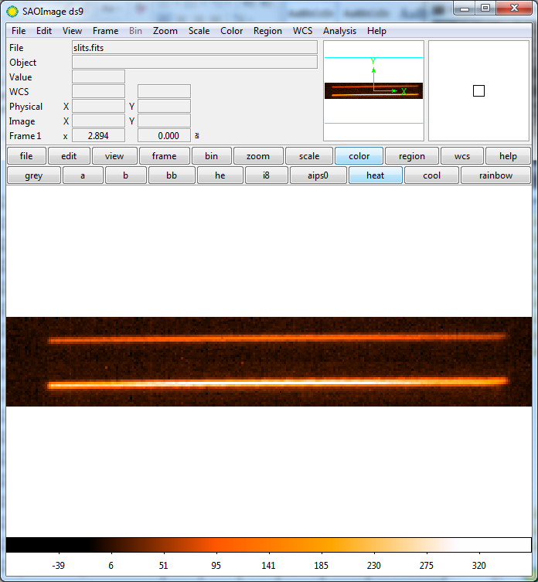
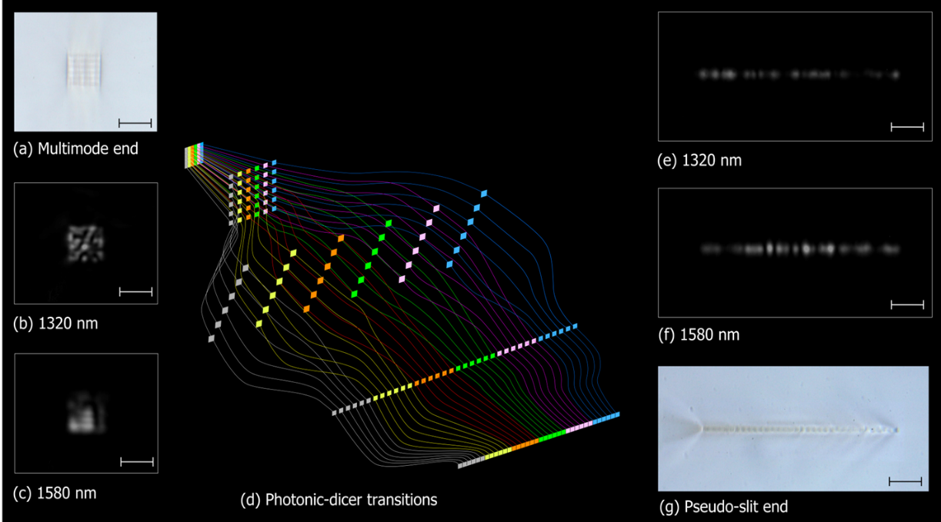
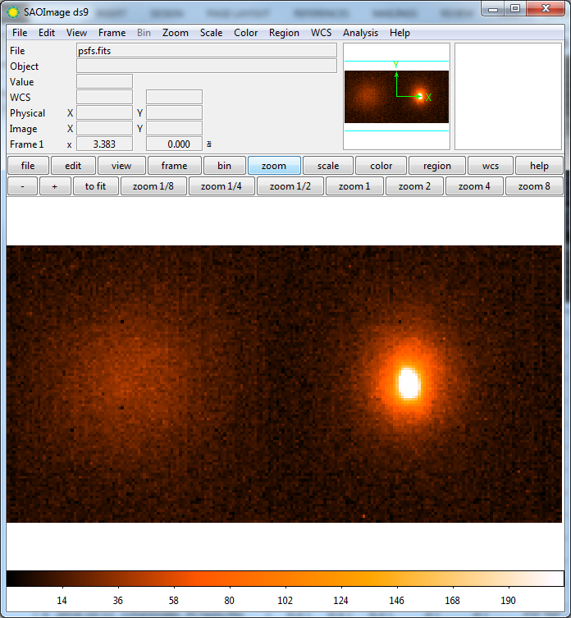
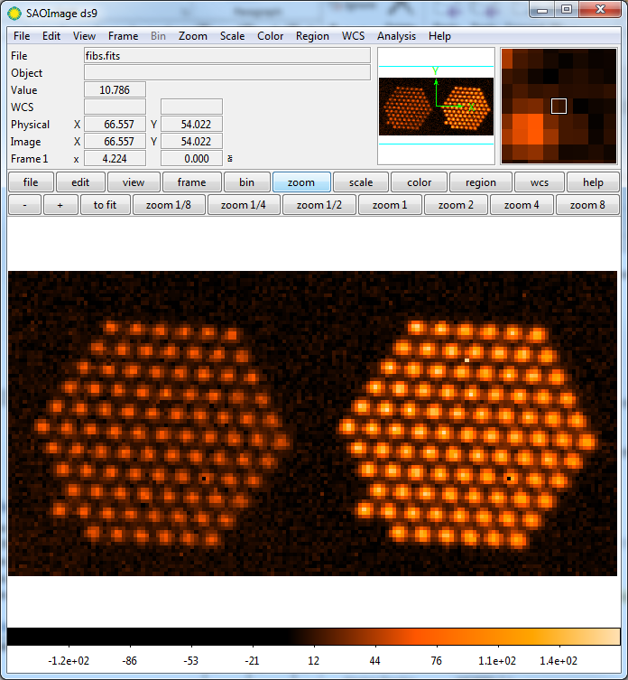
Photonic reformatter tests with Canary
Output single-mode slit
See Robert Thomson’s talk
PHOTONIC LANTERN: Good coupling efficiency observations into a single-moded slit
Very preliminary analysis…
Uncorrected
15%
Corrected
34%
Reference 1550nm PSF
Intermediate single modes
Uncorrected
Corrected
Uncorrected
Corrected
Canary AO
(Durham/{Paris)
Photonic Lantern
(Bath)
Waveguide network made
By Ultrafast Laser Inscription
(Herriot Watt)

Slide 29
Waveguide reformatter as AO WFS?
Simplify wavefront sensing using output from slit itself?
Reformatter measures power in modes which are low-order in the SMFs but low or high order in the MMF
How to determine link between aberration and SM output? (“Poke matrix”; “Timplex”…)
Sensitive to details of geometry, flexure and temperature ?
Low-order in single-mode fibre
(Degenerate)

Slide 30
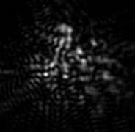
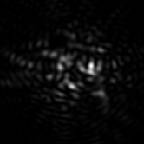
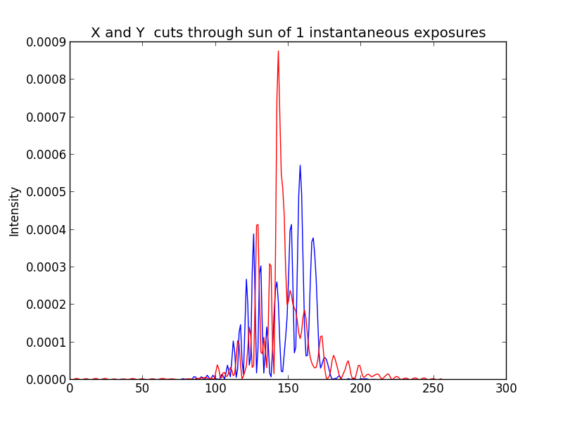
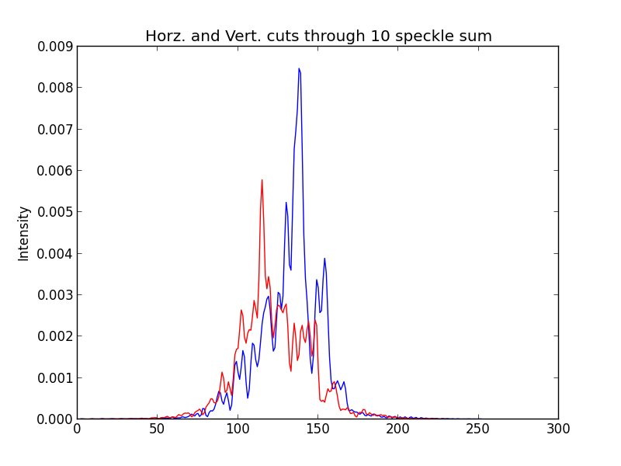
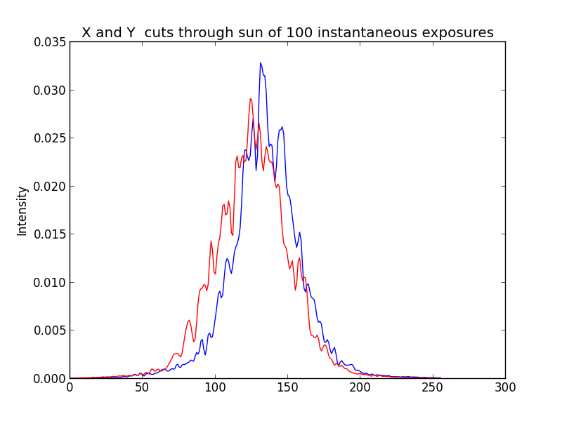
Defeat modal noise?
Modes partly coherent -> interfere to form speckle patterns
These changes unpredictably to cause statistical error due to number of speckles within field or pupil stop
Adds noise to spectrophotometry
PSF uncertain: sky subtraction error
Solution: mechanically agitate to smooth out speckle pattern on all time scales - but difficult for highly muliplexed spectroscopy
ρ
M = number
of modes
100 snapshots
1 snapshot
10 snapshots
History: Baudrand and Walker (1972); Goodman and Rawson; Grupp,
Lemke, Corbett, Allington-Smith and Murray 2011 MNRAS 417, 689,
See also Ramsay et al.

Slide 31
Modal noise: visibility model
Decoherence due to
different propagation constants of modes (analoguous to ray angles)
Spectral content (visibility increases with R
Visibility due to decoherence:
Lemke et al. 2011 MNRAS 417, 689
Prediction for M = 900 (measured from speckles)
LNA
theoretical SNR, v_{C}
Obtainable SNR = --------------------------------
measured visibility
But modes do not coherently interfere in photonic dicer..?

Slide 32
Conclusions
Adaptive Optics and Photonic spectroscopy are a natural combination for precision spectroscopy
A lot of work still to be done
The end

