Slide 1
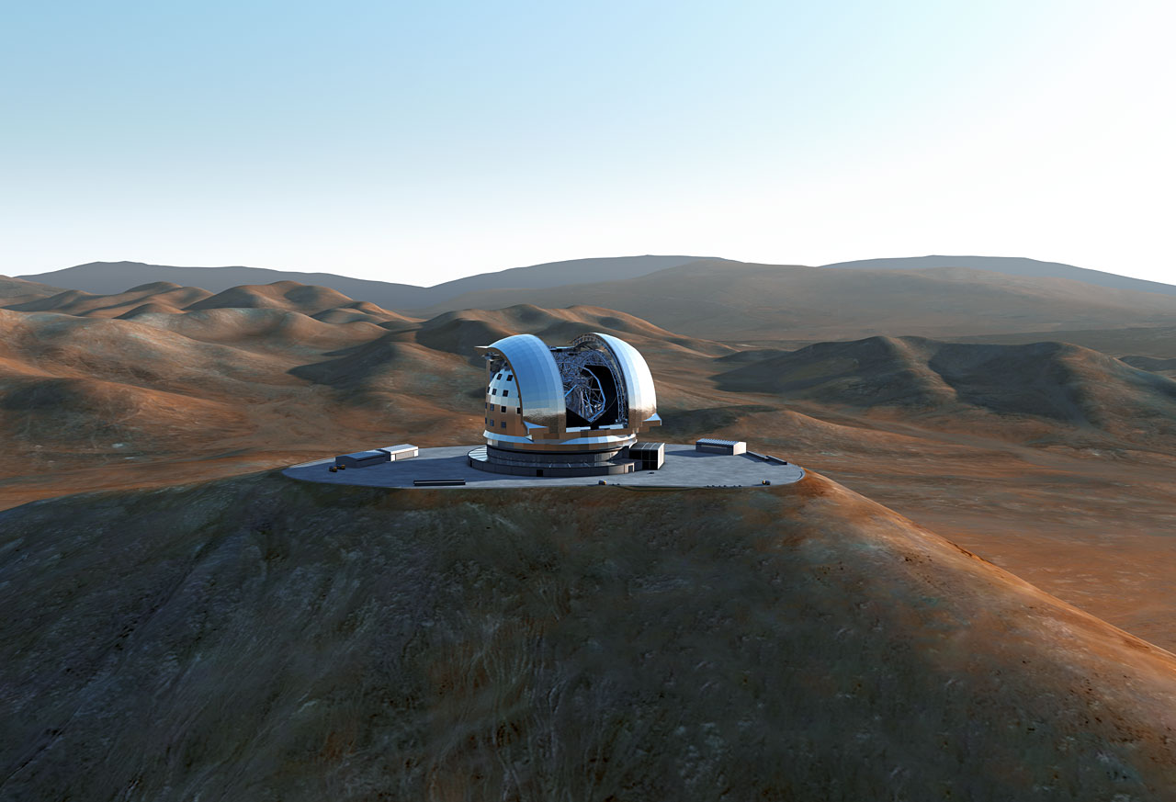



The European ELT and Exoplanets Florence Workshop Nov. 2014
Colin Cunningham
UK ELT Programme Director
Chair OPTICON Innovation Network

Slide 2
OPTICON Innovation Network: Objectives
Running technology focussed workshops that will bring together scientists, engineers and technologists from the astronomy community and in particular the OPTICON R&D work packages (WP1-6) with their peers from industry, knowledge transfer professionals and other relevant science sectors
Further developing the technology roadmap that has been a fundamental tool of the previous Key Technology Network, and using this to encourage academic/industrial consortia to bid for further technology development funding
Setting up an Industry Club to bring together companies that wish to bid for contracts and develop technology in Optical and Infrared Astronomy, and to exploit our technology in other fields.

Slide 3
OPTICON Innovation Network Workshop
‘Photonic Technologies and Techniques for Exo-planet instrumentation’
Novel coronagraphic techniques
Detectors
High resolution spectroscopy
Calibration – Laser Combs
Astrophotonic devices
New ideas?

Slide 4
Acknowledgements: mostly borrowed from ‘Exoplanets with E-ELT’, Garching Feb 2013
Bernard Brandl
Ignes Snellen
Markus Kasper
David Charbonneau
Andreas Quirrenbach
And Nicolas Blind: SPIE 2014
Notes:
Add webpage snip

Slide 5
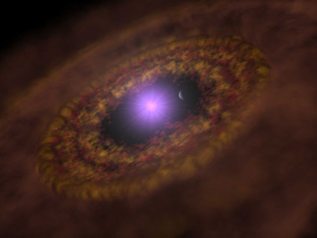
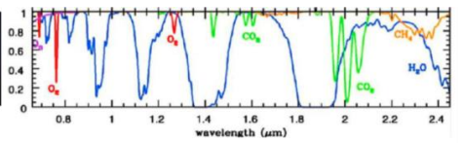
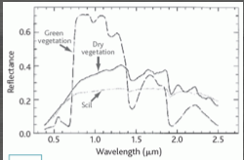
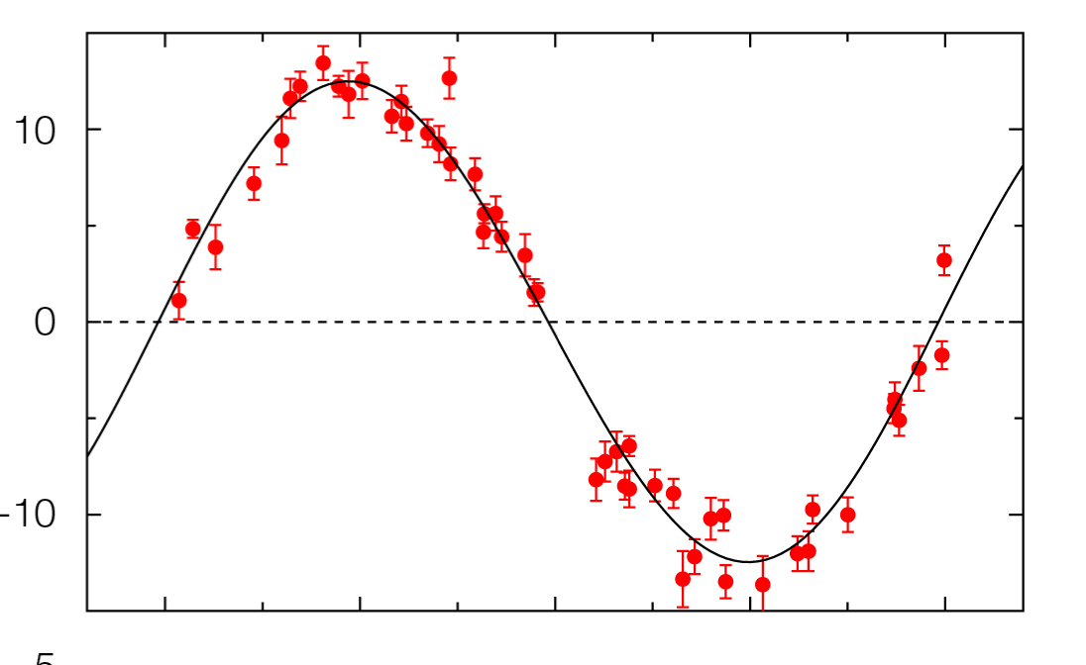
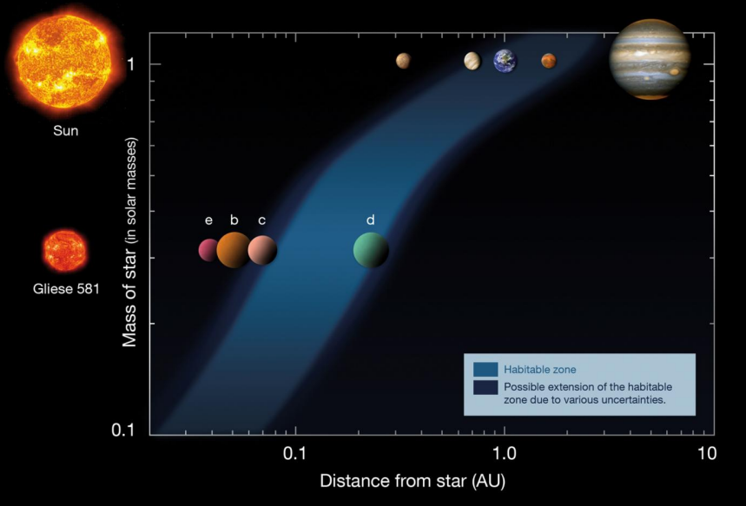
Exoplanets: Are we alone?
How do planetary systems form?
How common are systems like ours?
What atmospheres do planets have?
Are there other Earths?
Can we detect signs of life?
Direct Detection
Spatial resolution (with exAO) & sensitivity to detect the planets NIR
the dusty disks in which they are forming in the MIR
Indirect method: Radial velocity
Potential to reach lower-mass planets
ELT provides required collecting area
cm/s precision required for Earth-like planets
Characterise Atmospheres
Constituent elements, signs of life
Notes:
Key questions
Habitable zones
Direct & indirect detection
Atmospheric signatures (vegetation, O, CO2 & CH4)

Slide 6
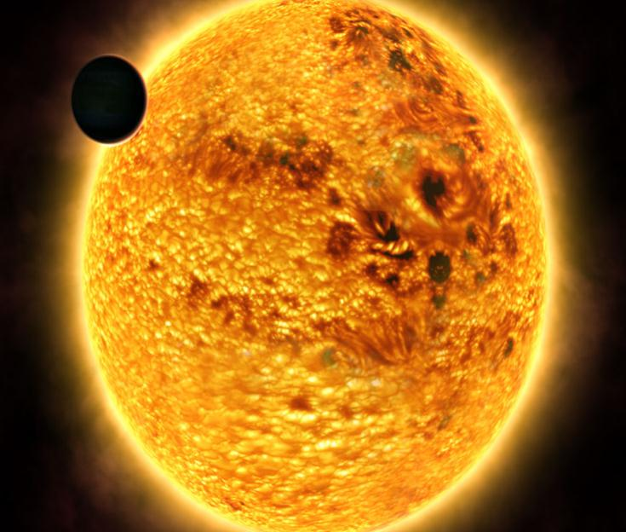
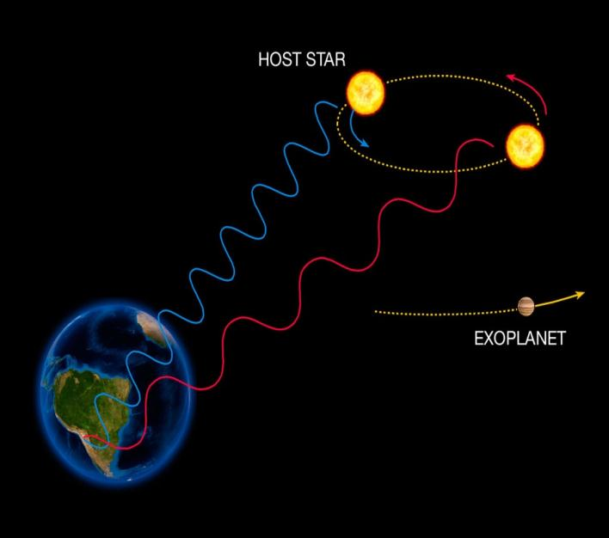
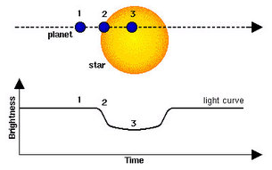
Exoplanet Detection Methods

Slide 7
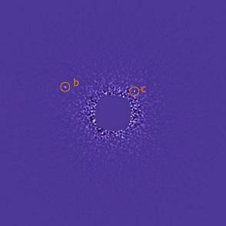
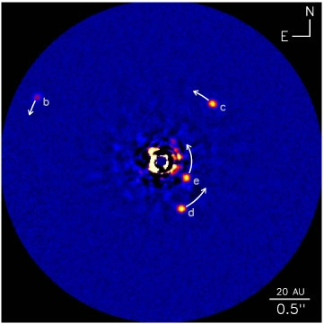
Exoplanet: direct imaging HR 8799: 140 light years away, 1.5 times the size of our Sun and five times more luminous
Gemini North adaptive optics image shows two of the three confirmed planets
~7 Jupiter-mass planet orbiting at about 70 AU
~10 Jupiter-mass planet orbiting the star at about 40 AU
Keck AO follow-up AO image showing third & fourth planets!
Gemini Observatory, NRC-HIA, C. Marois, and Keck Observatory
Notes:
Angular Differential Imaging (ADI):
The Angular Differential Imaging (ADI) technique is a specialized observational and data reduction method that uses the intrinsic slow field-of-view rotation of altitude/azimuth mount telescopes to suppress (via image post-processing) the bright star light. The technique also suppresses noises associated with the atmosphere and imperfections in the optics of the telescope and instrument systems and reveal the light of faint nearby planets. During an acquisition, the infrared camera is kept aligned with the telescope while the sky orientation is slowly rotating. A data reduction pipeline is then used to construct and subtract a reference star image that does not contain the flux of the planets. Residual images are then rotated to align the field and median and combined to enhance the sensitivity to planets.
OK

Slide 8
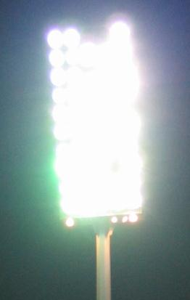
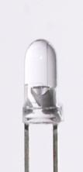
Direct Detection: the problem
10 cm
Borrowed from Joe Liske

Slide 9

Sun-Earth from 30 light years
star-to-planet contrast for rocky planets in the habitable zone at optical/IR wavelengths is of the order 10⁹
200 km

Slide 10
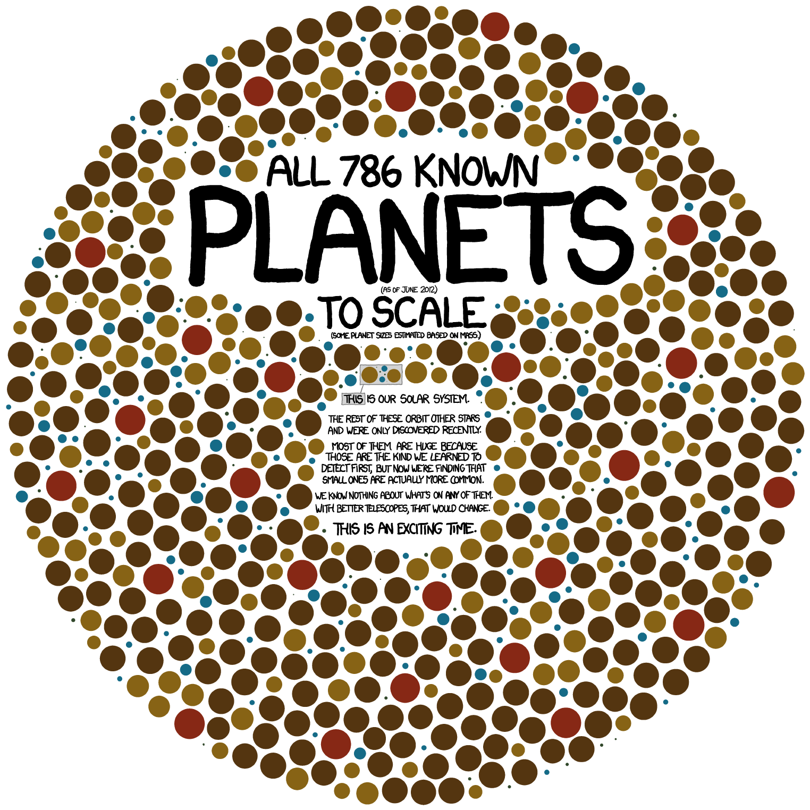
Exoplanets: Direct Detection and Spectroscopy

Slide 11
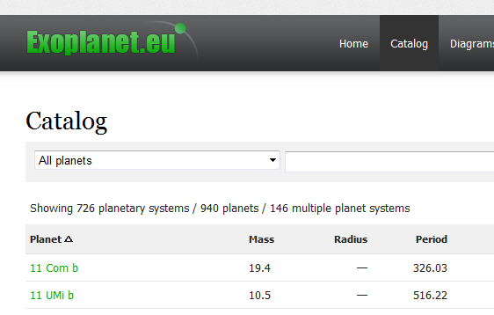
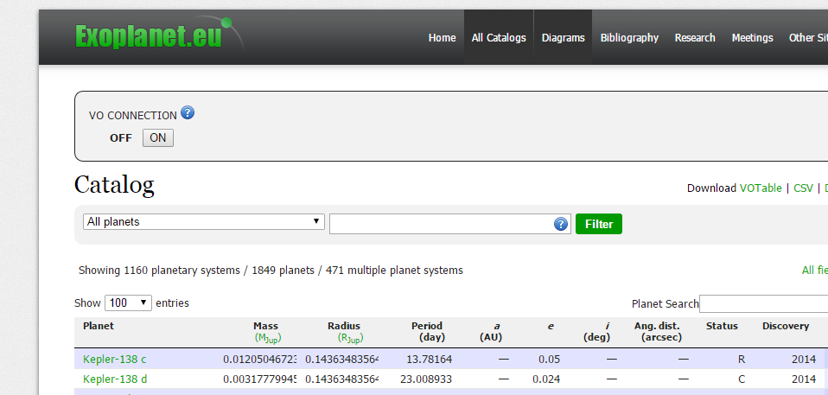
November 2013
April 7th 2014
November 5th 2014

Slide 12
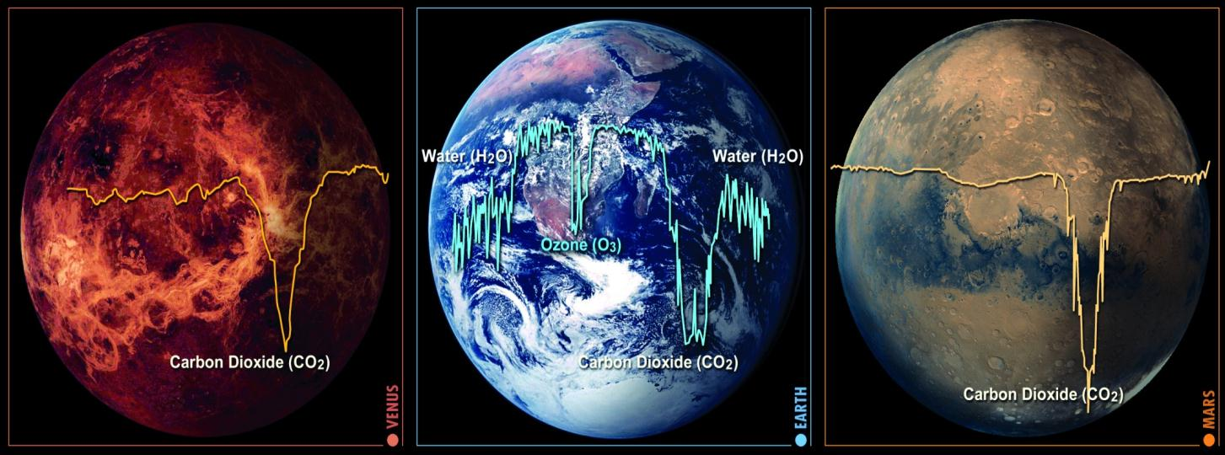
Probing Exoplanet Atmospheres

Slide 13
Exo-planet detection and characterisation
Issues
Photonic Solutions?
Coronography
Ultra-smooth mirrors
Speckle cancellation
Differential Imaging
Integral field spectroscopy
Differential polarimetry
Multi-waveband IR detectors for differential imaging
Image slicers for IFS
Active liquid crystal devices
Vector Vortex Coronograph
Vector Apodising phase plate

Slide 14
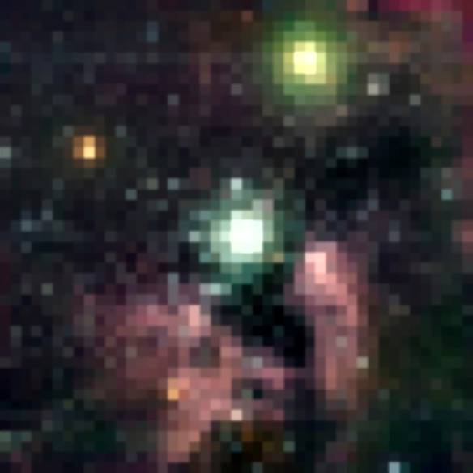



Why will the E-ELT revolutionise Exoplanet studies?
E-ELT excels in collecting power and angular resolution
39.3m telescope with Adaptive Optics will deliver
4.9 X better angular resolution (1/D)
510 X faster exposure time (1/D⁴)
than existing 8m telescopes
E-ELT
8m
Hubble Space Telescope
1 arcsecond
Unprecedented sensitivity and angular resolutipn
Notes:
Images on the left show a star forming regions and cycles through what HST -> E-ELT can resolve (from Gilmozzi)
The right is Gemini’s AO movie that I use because it shows an animation of a deformable mirror but can easily be replaced with another movie

Slide 15
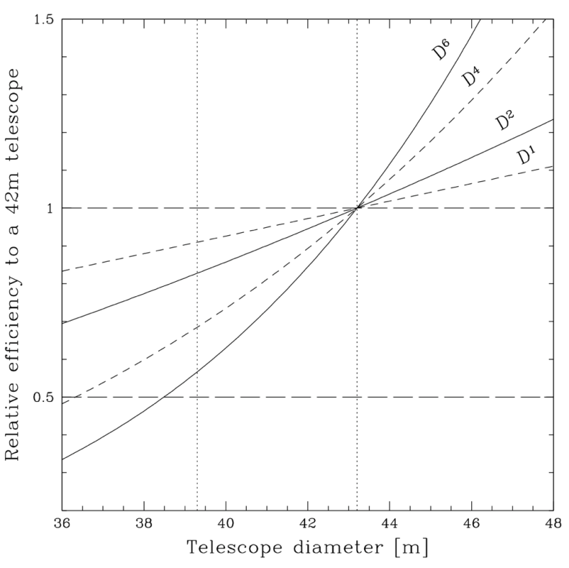
How do Science Cases Scale with Diameter?
Key cases that scale as ~D⁰:
RV search of exoplanets
So don’t use E-ELT!
Key cases that scale as ~D¹:
resolution limited cases (e.g. resolved stellar pops)
Key cases that scale as ~D²:
photon limited cases (e.g. cosmic expansion - CODEX)
Key cases that scale as ~D⁴:
AO limited cases (e.g spectroscopy of Virgo stars)
Key cases that scale as ~D⁶⁺:
direct imaging of exoplanets
E-ELT will have advantage over TMT & GMT
-9%
-17%
-44% to -50%
Markus Kissler-Patig
Notes:
So, key science with E-ELT is not planet search, but characterisation

Slide 16
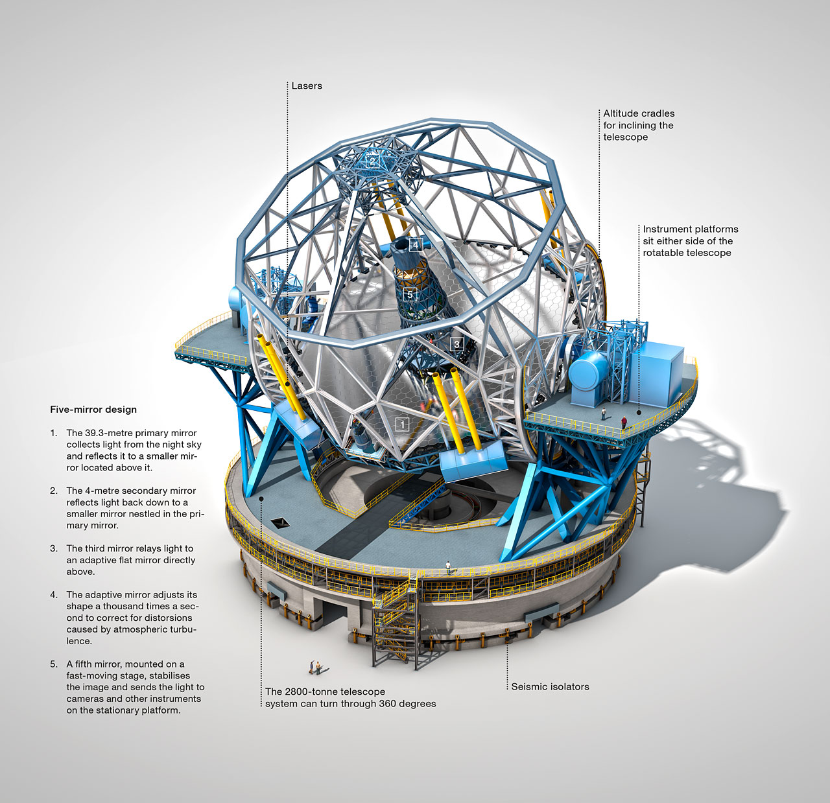
What are the E-ELT challenges?
16

Slide 17
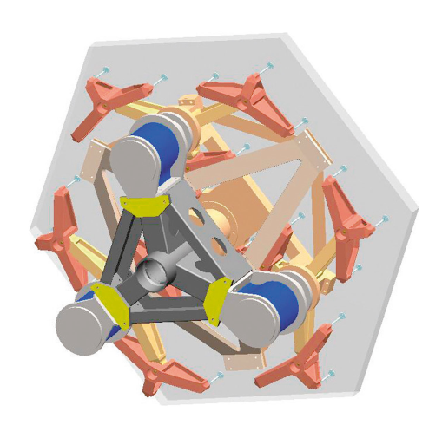
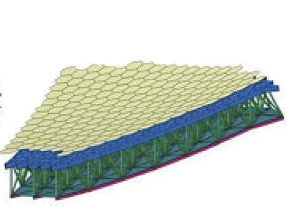
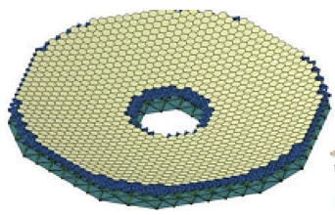
E-ELT Primary Mirror
Maintain the shape and position of the telescope mirrors
Compensate for changing gravity as telescope moves around the sky
Compensates for temperature changes
798 segments + 133 spares (1/family)
Partial correction of image wander induced by atmospheric turbulence
Produces excellent image quality at infrared wavelengths
Notes:
More about the primary – point out the 3 actuators behind each segment, but also the underlying structure that supports this mirror

Slide 18
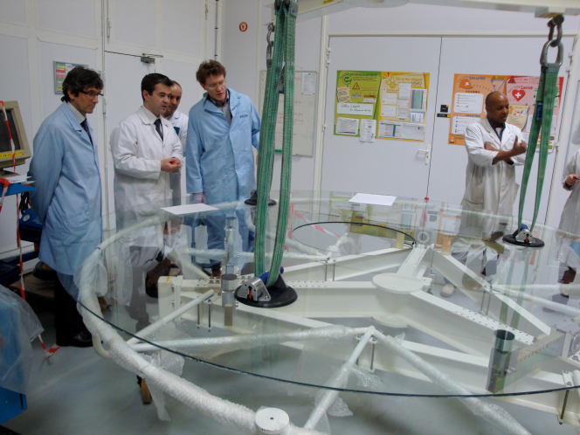
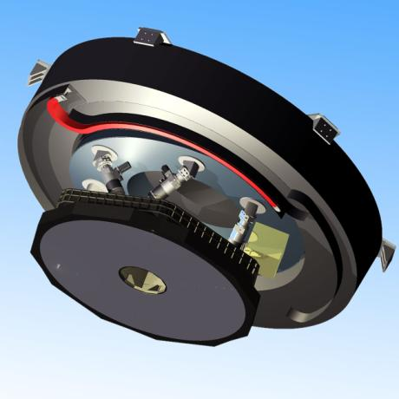
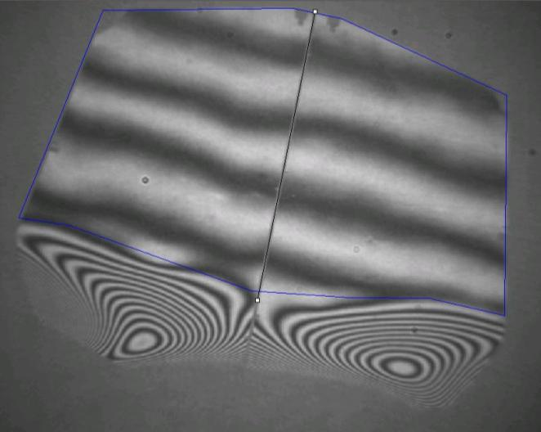
Segmented M4: 2.5m flat adaptive mirror 5790 actuators

Slide 19
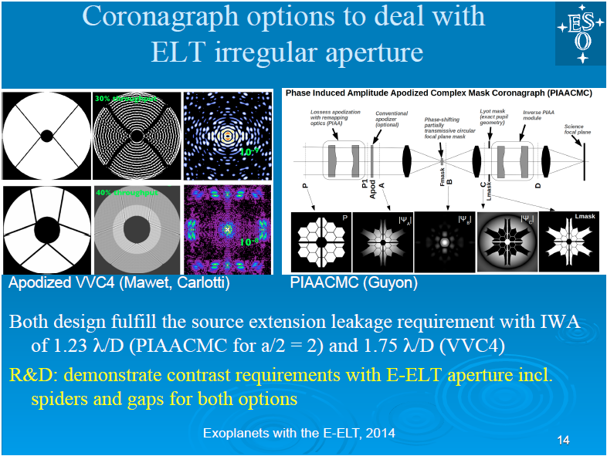
Notes:
Apodized Pupil Complex Mask Lyot Coronagraph (APCMLC), relies on a transmission mask to perform the pupil apodization, the second concept, called Phase-Induced Amplitude Apodization complex mask coronagraph (PIAACMC), uses beam remapping for lossless apodization. Both concepts theoretically offer complete coronagraphic extinction (infinite contrast) of a point source in monochromatic light, with high throughput and sub-λ/D inner working angle, regardless of aperture shape.
High Performance Lyot and PIAA Coronagraphy for Arbitrarily Shaped Telescope Apertures
Olivier Guyon^{1,2}, Philip M. Hinz¹, Eric Cady³, Ruslan Belikov⁴, and Frantz Martinache²
Show affiliations
Olivier Guyon et al. 2014 ApJ 780 171. doi:10.1088/0004-637X/780/2/171 Received 21 June 2012, accepted for publication 28 May 2013. Published 23 December 2013. © 2014. The American Astronomical Society. All rights reserved.

Slide 20
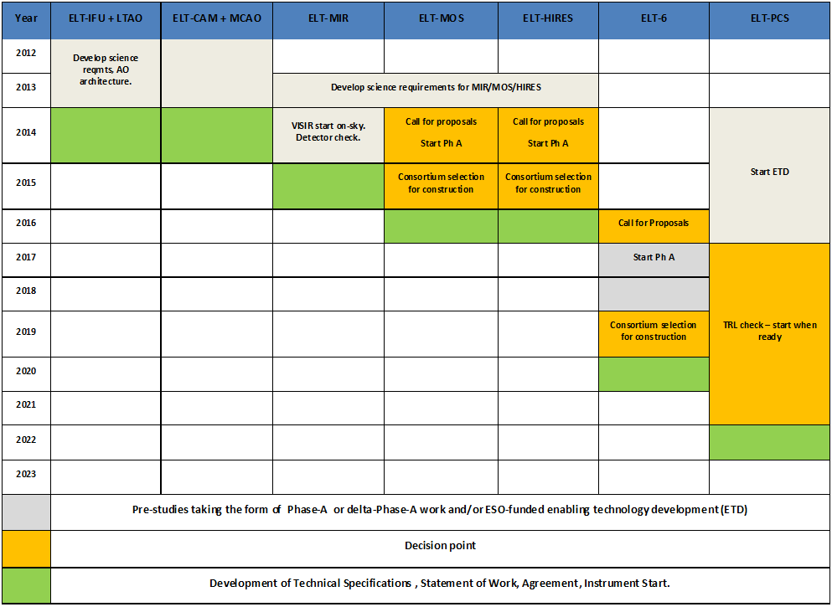
E-ELT Instrumentation: ESO Roadmap
Two 1st-light instruments
Future decision points mapped out
HARMONI
METIS
MOSAIC
HIRES
EPICS

Slide 21
Which of the instruments have exoplanet science cases?
HARMONI: Integral field spectroscopy to separate planet from speckles. High contrast performance as exoplanet precurser instrument being evaluated
MICADO: Imager: may feature coronagraph, but we need PCS for full E-ELT performance
METIS: high resolution transit spectroscopy and coronagraphy
HIRES: high resolution transit spectroscopy
MOSAIC: RV-searches for giant planets in Galactic star clusters
PCS: Direct Imaging and Spectroscopy
ELT 6 ???

Slide 22
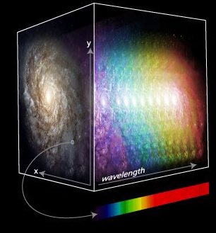
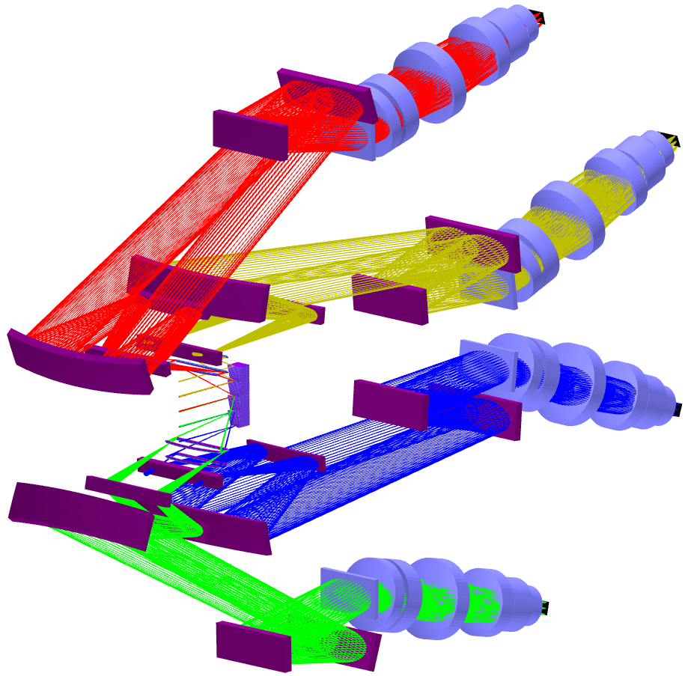
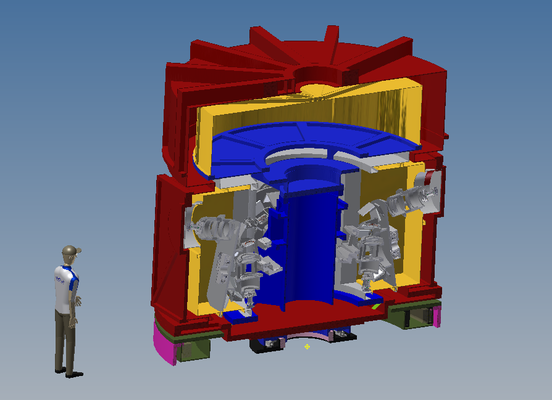
HARMONI Integral Field Spectrometer
PI: Niranjan Thatte (Oxford), UK ATC & consortium partners (France, Spain)
Low-Moderate spectral Resolution
Multiple spaxel scales
NIR + extension to ~0.5μm
Fed by natural seeing or various AO modes
Notes:
As this was a talk with emphasis on exo-planetary science I put in a link for HARMONI to show people what is being built here & link it to the exo-planet case
You might like to replace with your favourite instrument / science case here

Slide 23
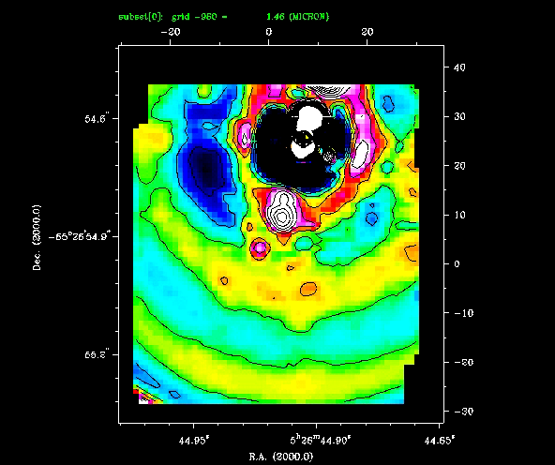
So Spectral Deconvolution with Integral Field Spectroscopy will be key
Thatte et al 2007
Notes:
Demonstrates spectral deconvolution with an IFU (test done with SINFONI)
As you step in wavelength you see that the airy pattern enlarges, including associated speckles that in any given frame may be mistaken for exoplanet candidates
The planet is stationary – can identify planets from optical features
The IFU allows the planet to be indentified but also produces a spectrum that can allow astronomers to classify the type & atmosphere of the planet
Need a E-ELT to approach such a study for rocky planets in the habitable zone around other stars

Slide 24
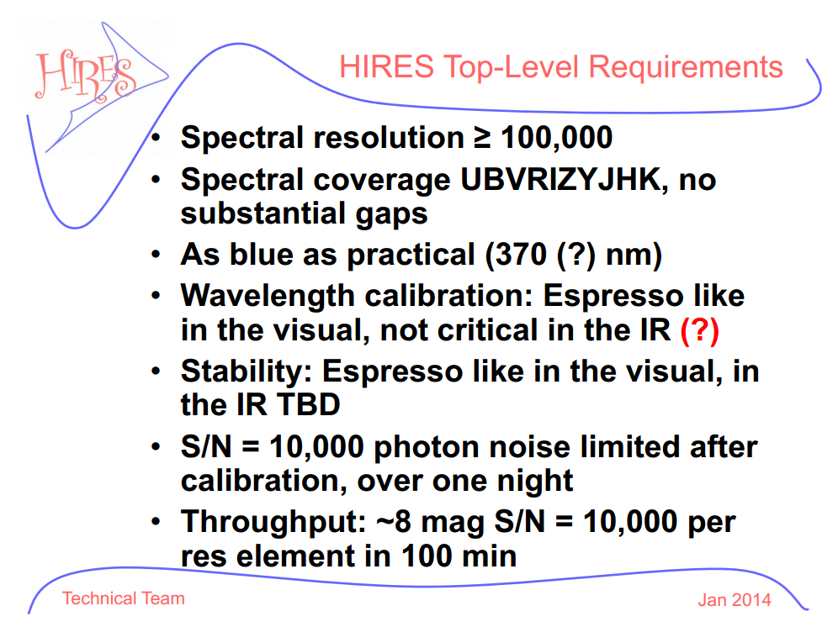

Slide 25
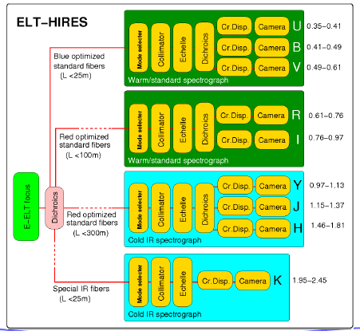

Slide 26
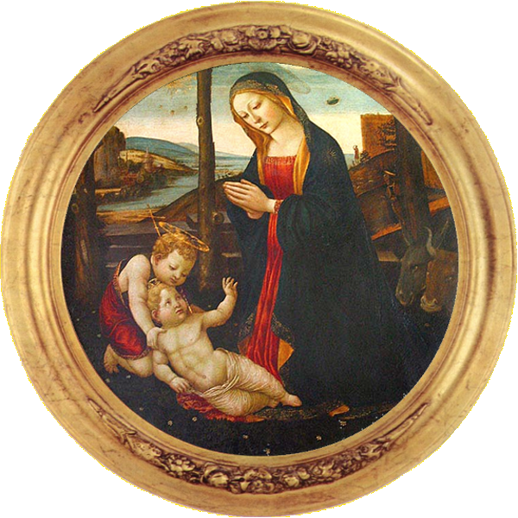
Exoplanets with HIRES
Radial Velocity measurements – probably not best use of scarce E-ELT time
But transiting exoplanets will have starlight passing through planetary atmosphere, modulated by radial velocity
Discover signs of life?
Notes:
Add image

Slide 28
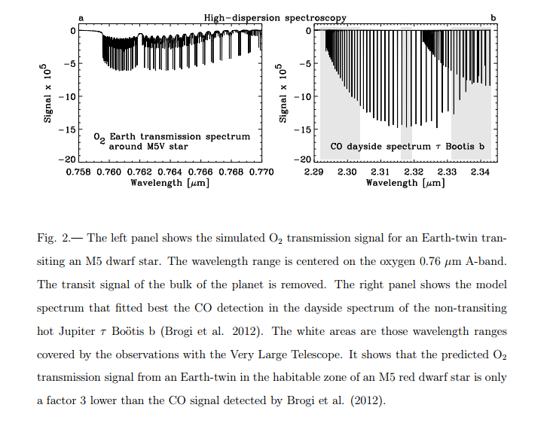
Finding extraterrestrial life using ground-based high-dispersion spectroscopy I.A.G. Snellen, R.J. de Kok, R. le Poole, M. Brogi, & J. Birkby1

Slide 29


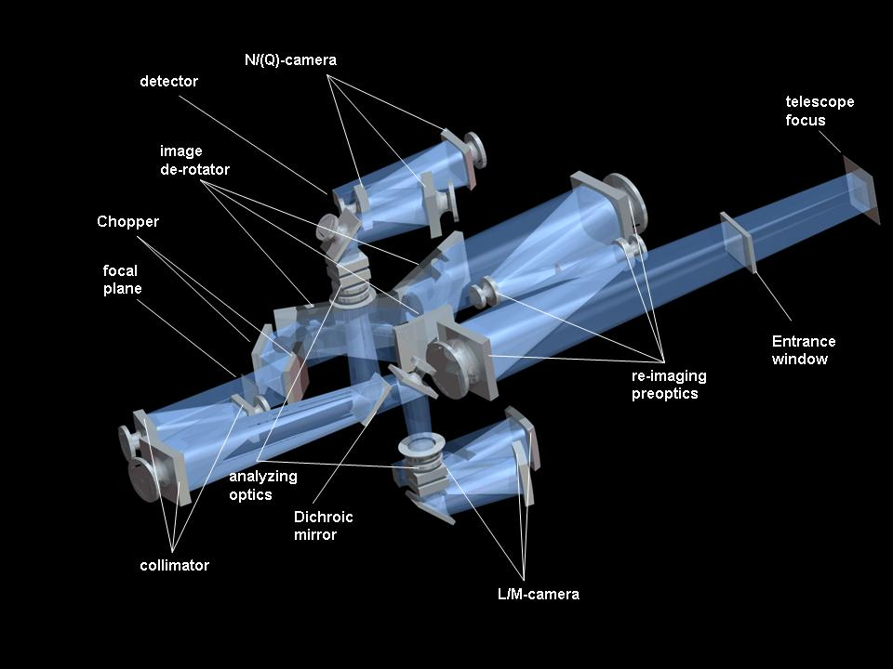
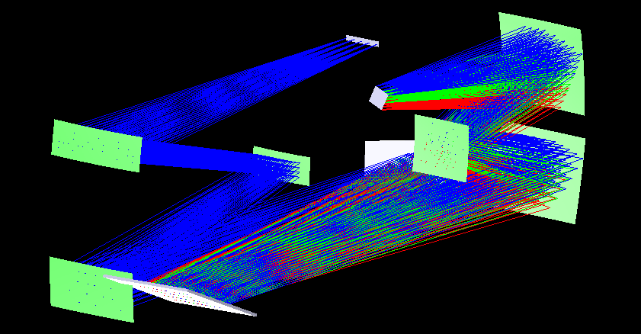
METIS Mid-infrared ELT Imager & Spectrometer
PI: Bernhard Brandl (Leiden)
Institutes: Leiden, UKATC, MPIA (Heidelberg), Saclay, Leuven
3-14μm
Imager: (FOV : 18”x18”, LMN)
Coronagraphy LMN
LowR (<5000) LMN long-slit spectroscopy
N-band polarimtery (TBD)
IFU mode (2.9um-5um, R=100,000, FoV 1.4”x1.5”)
Imager
Spectrometer

Slide 30
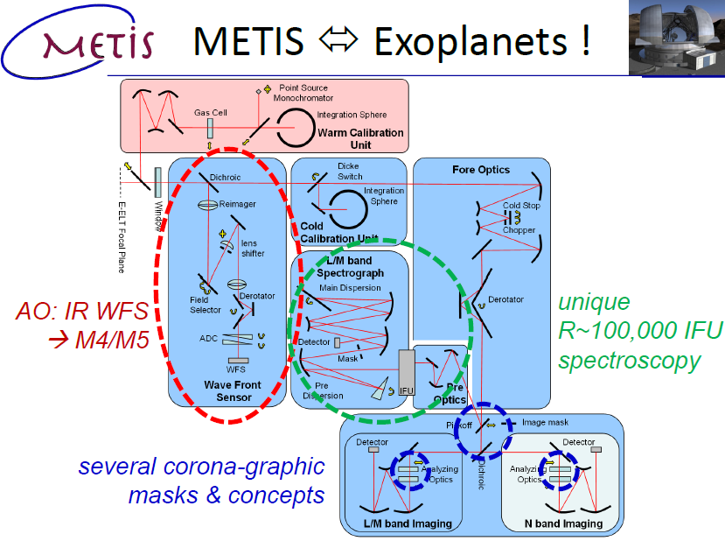

Slide 31
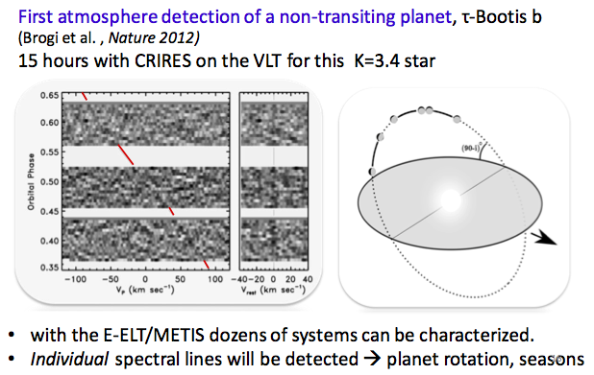
Transit Spectroscopy

Slide 32
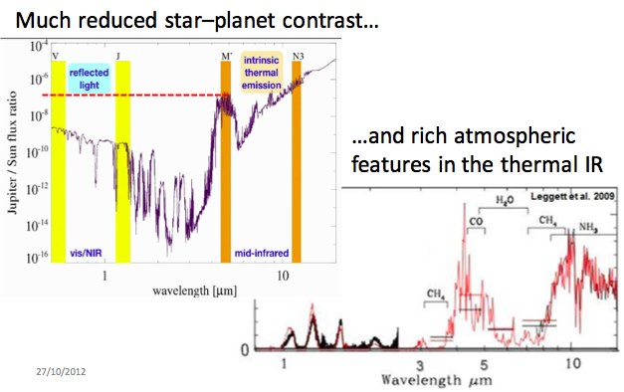
Exo-planets with METIS

Slide 33
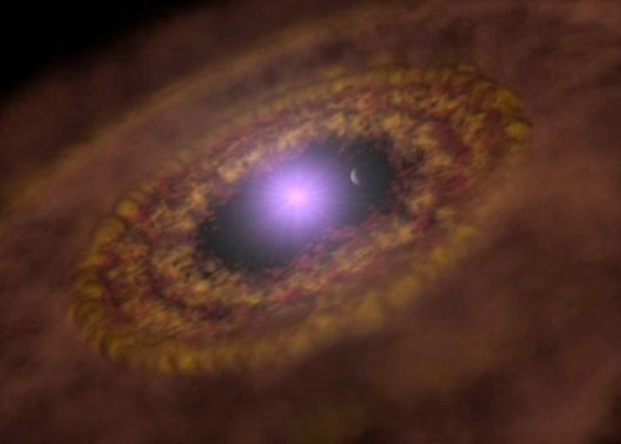
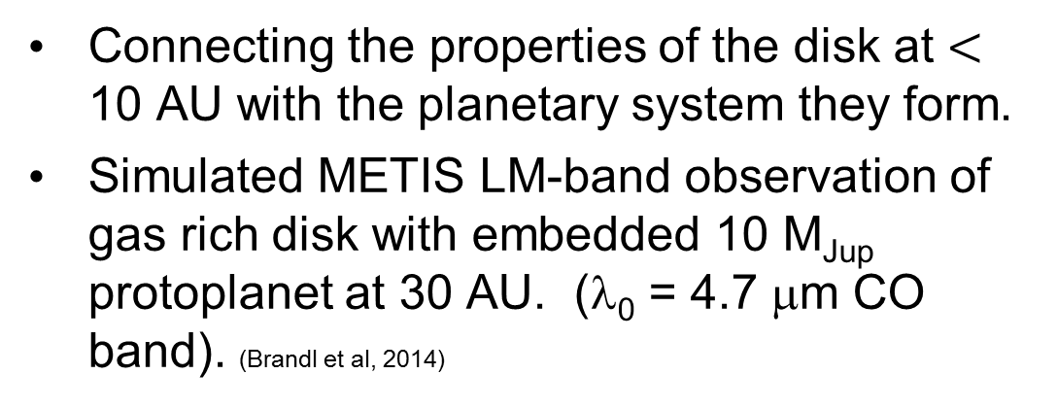
Understanding Planet formation with METIS
Connecting the properties of the disk at $<$ 10 AU with the planetary system they form.
Simulated METIS LM-band observation of gas rich disk with embedded 10 M_{Jup} protoplanet at 30 AU. (λ₀ = 4.7 μm CO band). (Brandl et al, 2014)
Notes:
Key is higher spatial and spectral resolution than JWST, at similar sensitivity.

Slide 34
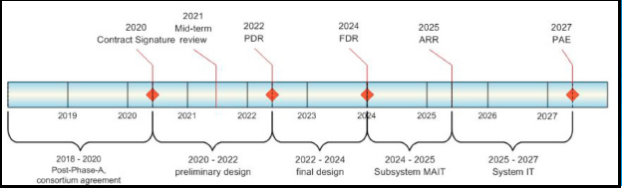
EPICS E-ELT Planet-Finder
PI: Markus Kasper (ESO)
Institutes: ESO, Oxford University, Grenoble, Paris, Padua, IAC (Tenerife), Zurich
Parameters (Phase I)
Extreme Adaptive Optics (XAO)
NIR wavelengths
Range of R (125-20000)
Differential imaging, polarimetry and IFU
Simulation by the EPICS team

Slide 35
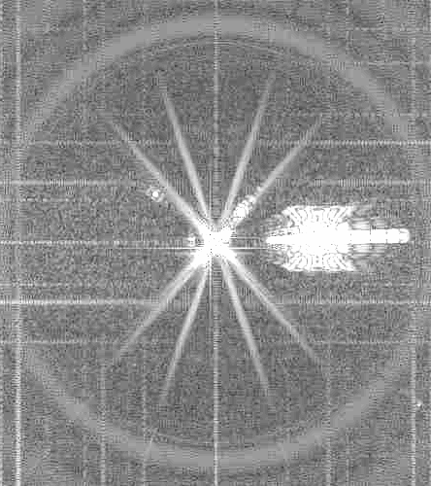
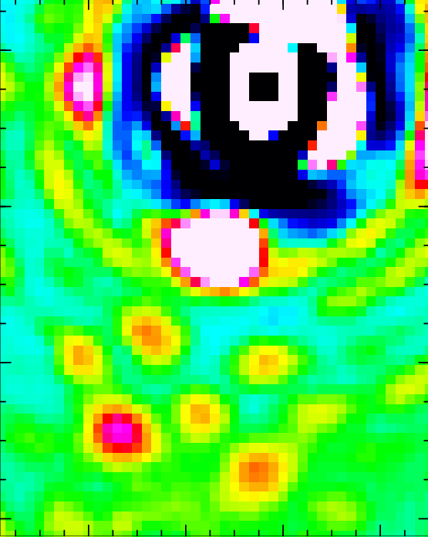
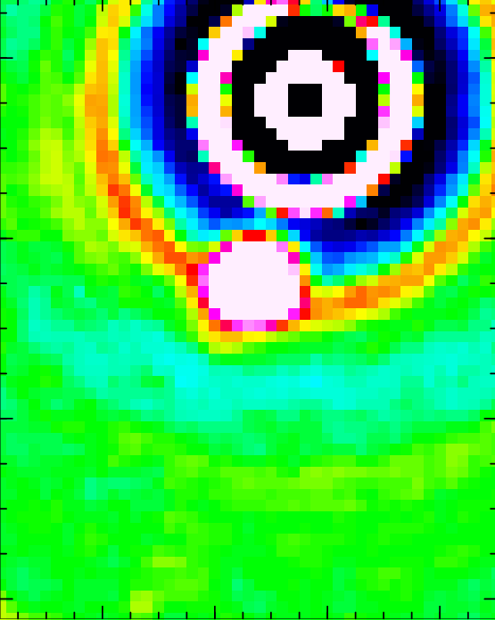
Direct detection of a “Super Earth”
Simulation including systematic effects (e.g. speckles)
10⁻⁸
10⁻⁷
0.2”
10⁻⁵
10⁻⁹
1.2 arcsecond
10⁻¹⁰
10⁻⁹
Speckle subtraction technique
AB Dor, VLT/ SINFONI (Thatte et al 2007)
Simulated image courtesy of EPICS team.
10 hours, J band - PRELIMINARY

Slide 36
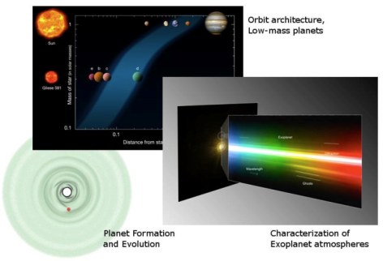
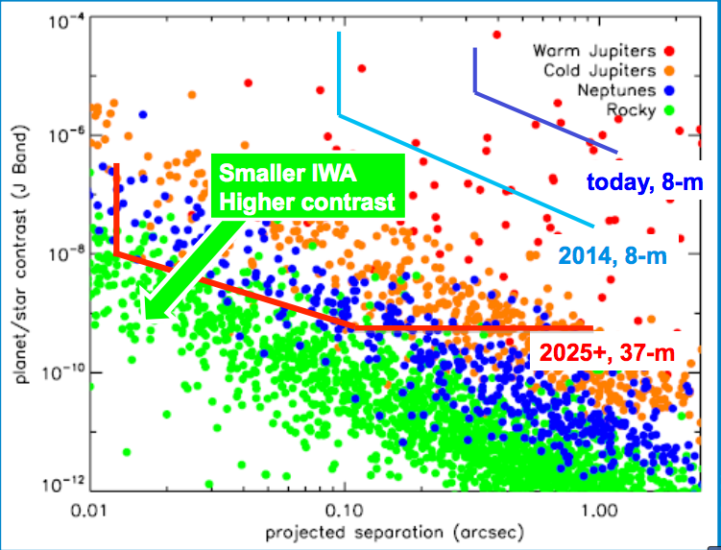
EPICS Science
Coming soon: SPHERE (VLT) & GPI (Gemini) in ~2011:
Angular separation: 0.1” < α < 1”
Contrast (@1.6 μm): 10⁻⁴-10⁻⁶
Young gas planets
EPICS (E-ELT):
Angular separation: 0.03” < α < 1”
Contrast (@1.6 μm): 10⁻⁷-10⁻⁹
Mature gas planets & massive rocky planets
Bonavita et al. 2012

Slide 37
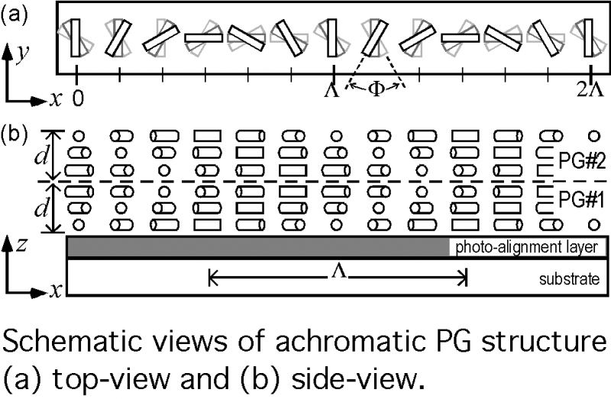


phase manipulation using liquid crystals polarization gratings
solid-state half-wave LC device
with orientation pattern
Escuti et al. (2006)
Packham et al. (2010)

Slide 38



phase manipulation using liquid crystals vector vortex coronagraph
solid-state half-wave LC device
with orientation pattern
Mawet et al. (2009,2010,2011)

Slide 39



Planet formation in different environments
ELT-MOS RV-searches for giant planets in Galactic star clusters
Motivation: role of stellar density vs. metallicity on planet formation?
Targets: open and globular clusters, spanning a range of metallicities
Strong synergies with results from Gaia-ESO survey
Requirements analysis underway for v2 of ELT-MOS White Paper
e.g. recent discovery of 3 planets around stars in M67 (Brucalassi et al. 2014)

Slide 40



E-ELT Status
14 European ESO Member States signed up
Early contracts for the project have already been placed:
Detailed design study for the very challenging M4 adaptive mirror of the telescope
Consulting Engineers for Dome & Main Structure: Ramboll (Denmark/UK)
Civil works: contract let for:
preparation of the access road
levelling of the summit started – June 16th
Call for Tender on Dome and Main Structure now out

Slide 41


Brazil
President Dilma Rousseff has recommended approval to Congress
Going through committees with ‘high priority’ – since 2010!

Slide 42


…but approved by STC, going to Finance Committee this week and ESO Council Dec 4th

Slide 43

Impact of E-ELT
Doubles photon collecting area of current 2-10m telescopes
Angular resolution could be 5 mas at 1µm if XAO works as predicted
Up to 500 times more sensitive than 8m telescope if D⁴ law is followed – e.g. diffraction limited
Exoplanets are a major science driver – and of course have great public interest

Slide 44
Photonic Techs for Exoplanets
Laser Combs
Active Coronographic speckle reduction
Bragg grating OH suppression
Tuned Bragg gratings to remove earth atmospheric gas signatures?
Photonic Lanterns to optimise coupling to PSF
Others? Metamaterial active transmissive phase corrector?

Slide 45


Slide 46


Slide 47


Slide 48



Slide 49
It’s a workshop! Work to be done:
Evaluate coupling of the ELT to photonic lantern – AΩ limitations?
Solution:
Lenslet array, feeding subapertures of PSF to array of photonics lanterns? – See Robert Thomson’s talk
Identify topics for next OPTICON proposal for Horizon 2020 – by March 2015

Slide 50


