Slide 1
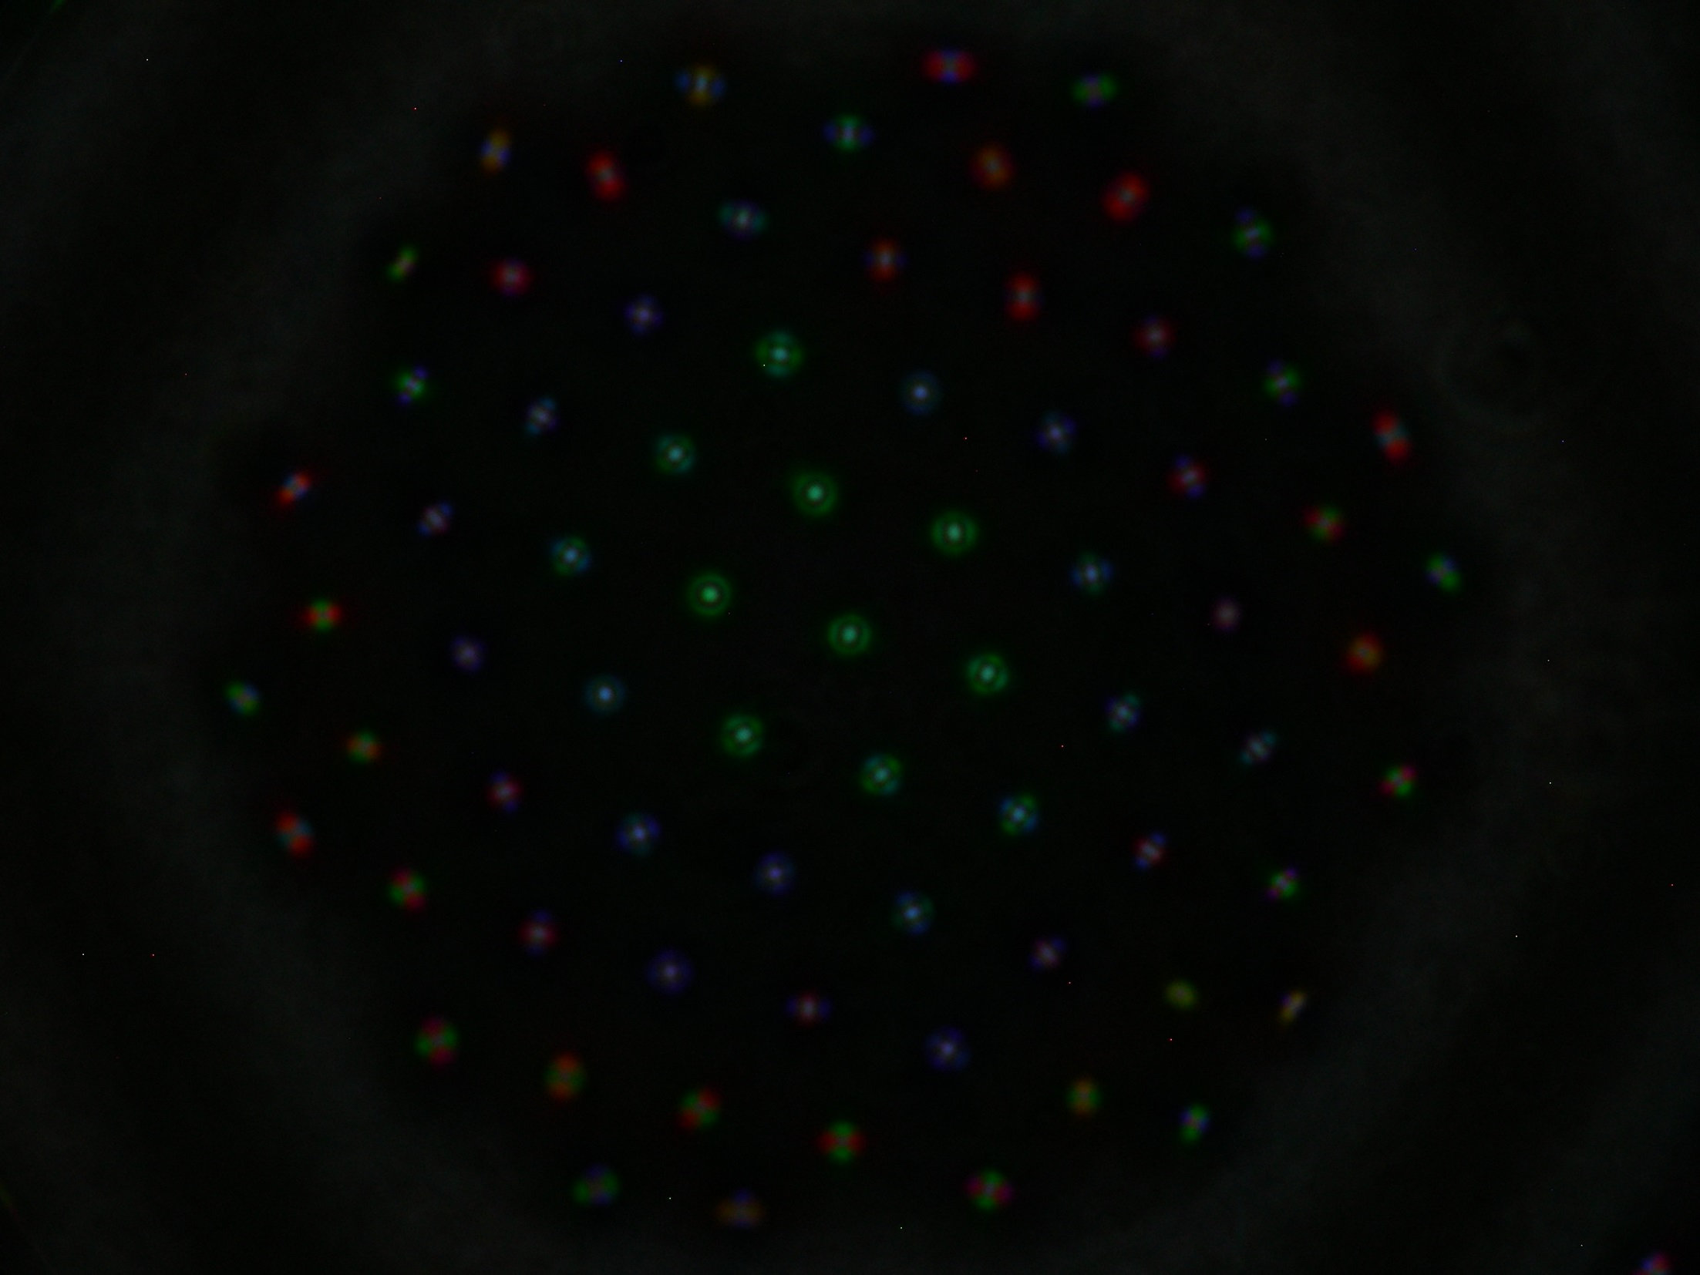
Multicore fibres and photonic lantern
Itandehui Gris-Sánchez
University of Bath, UK
6 November 2014

Slide 2


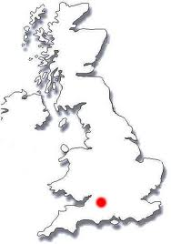
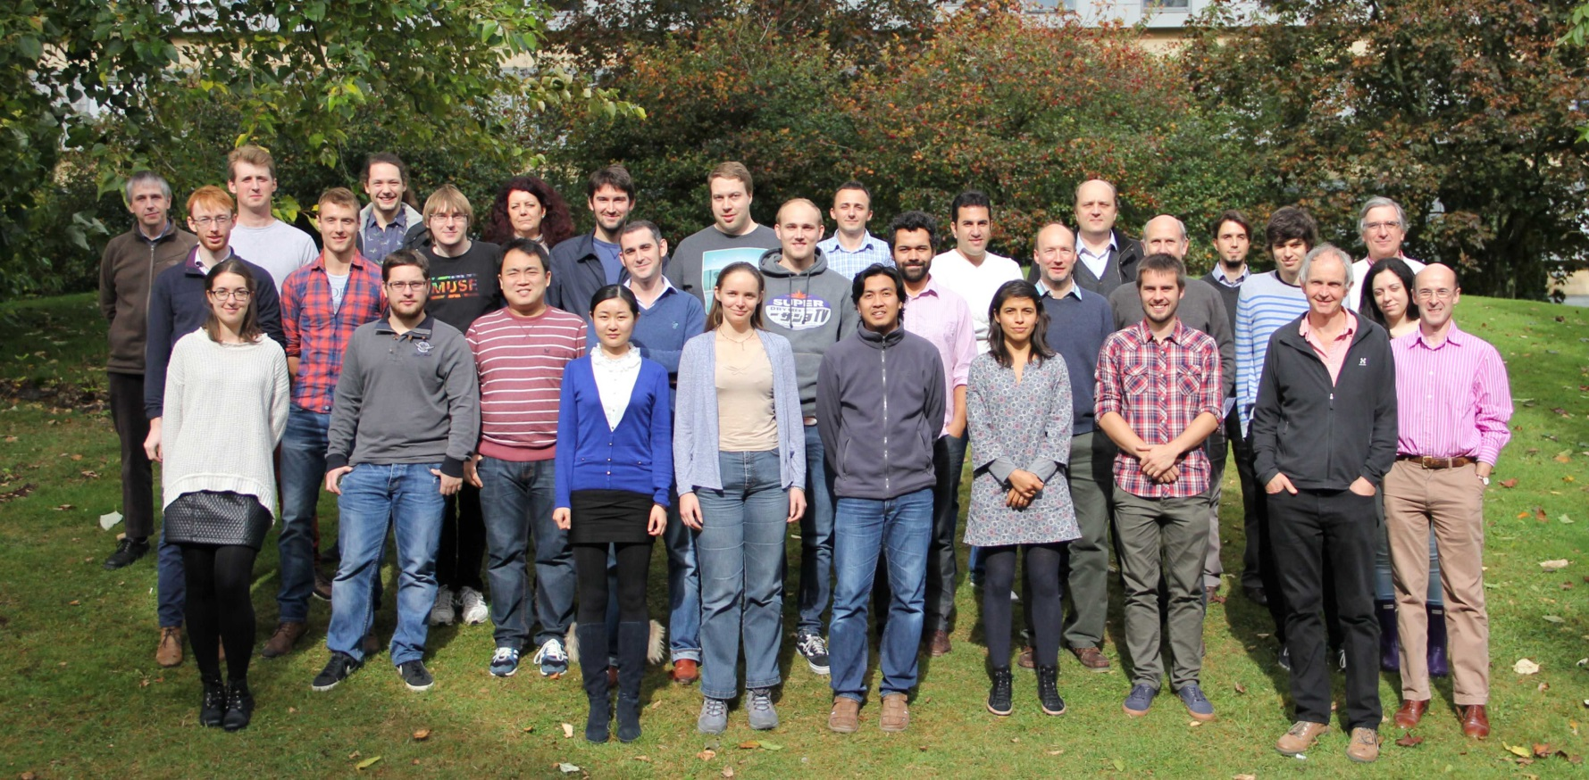
Photonics for planets

Slide 3
What is an optical fibre?
Optical waveguide made out of a dielectric material most commonly high purity silica glass, usually several km long.
Typical low loss window:
800 nm to 1600 nm.
Photonics for planets

Slide 4
How does an optical fibre guide light?
Geometric optics?
Huygens-Fresnel principle
Photonics for planets
http://drhart.ucoz.com/Research/fiber_modes.png
Notes:
What is a mode?
Stationary solution of the envelope of the field. Result from the interference of the wavelets reflected inside the fibre

Slide 5
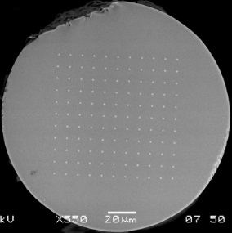
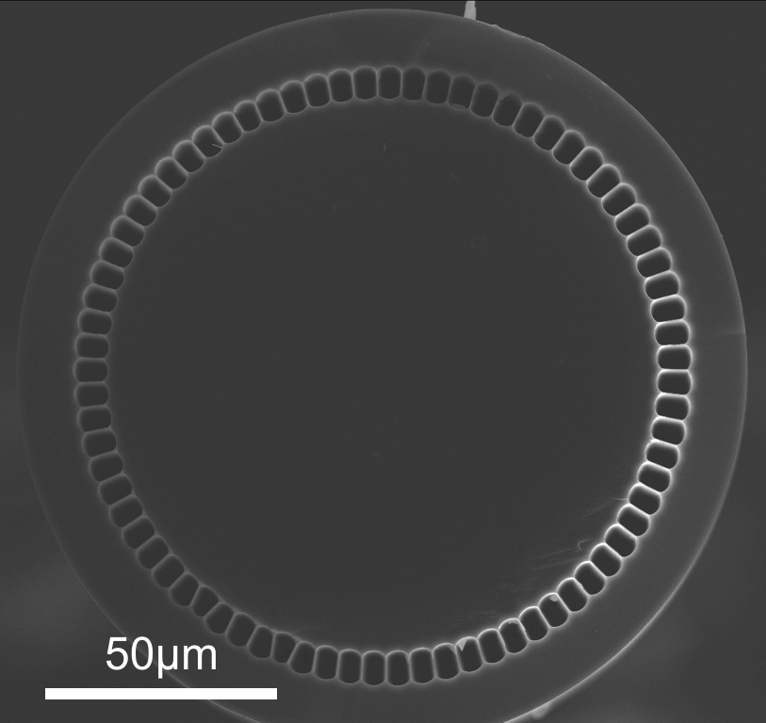
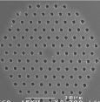
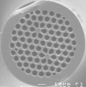
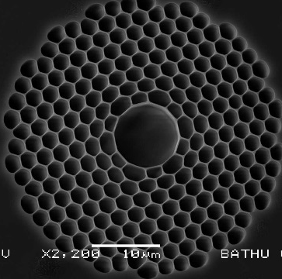
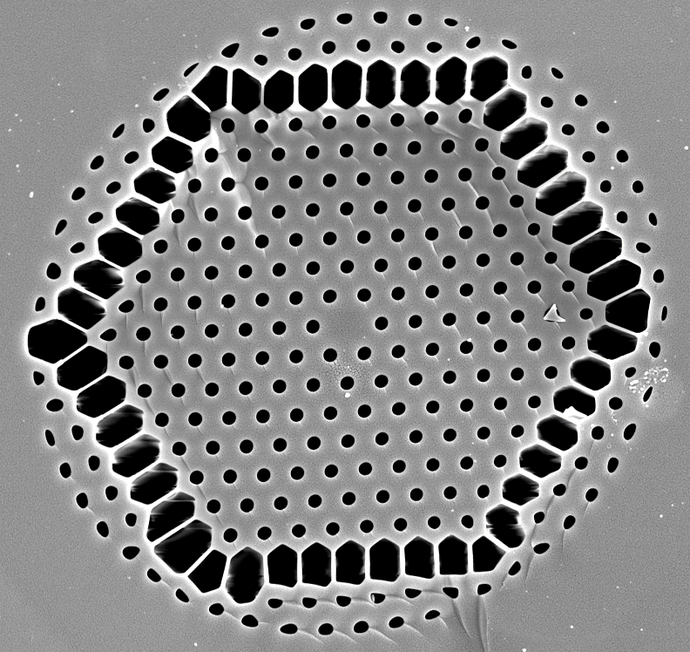
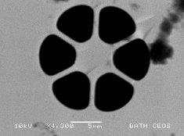
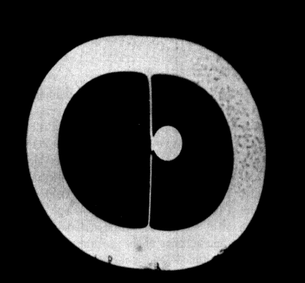
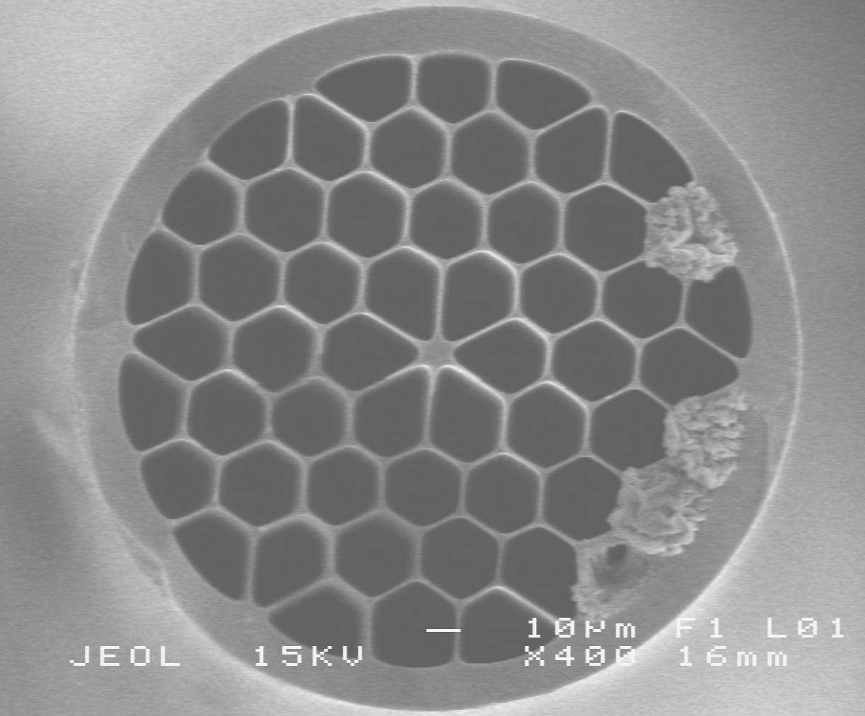
Standard vs Specialty
Photonics for planets
Notes:
Optical fibres as commonly know are widely used in telecom industry. The understanding of the physical guiding mechanisms is clear and the fabrication is cheap and fibre now have high performance telecommunications. Changes in the geometry design and in the materials effectively change guiding mechanisms

Slide 6
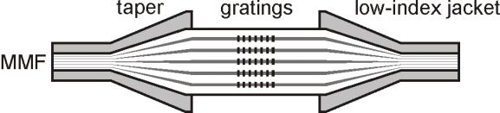
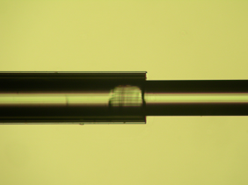
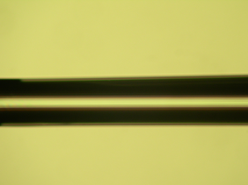
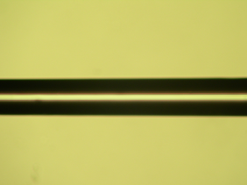
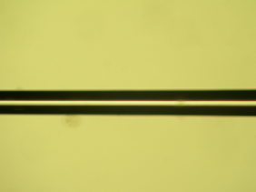
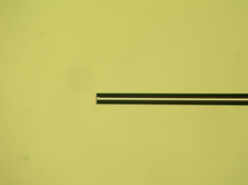
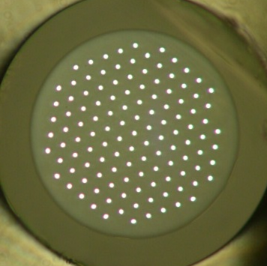
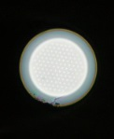
Previous work:
Multicore fibre terminated with lanterns
TA Birks et al, Opt Express 20 (2012) 13996
Photonics for planets

Slide 7


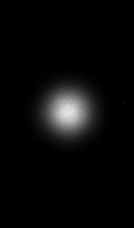
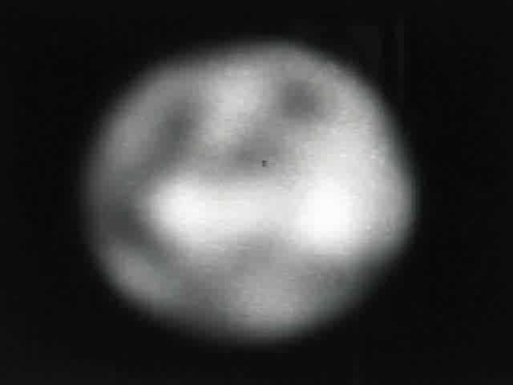
Step-index MMF
mode scrambler:
input
step-index MMF
TA Birks et al, Opt Express 20 (2012) 13996
Photonics for planets

Slide 8

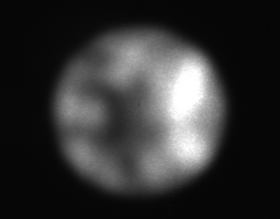

Lantern-terminated MCF
mode scrambler:
input
step-index MMF
MCF with lanterns
TA Birks et al, Opt Express 20 (2012) 13996
Photonics for planets

Slide 9
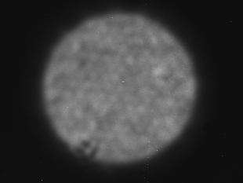
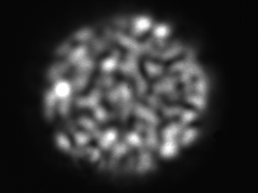
Lantern-terminated MCF
mode scrambler:
t = 0.1 s
input
step-index MMF
MCF with lanterns
TA Birks et al, Opt Express 20 (2012) 13996
Photonics for planets
Notes:
MCF (121 identical cores) act as a mode scrambler

Slide 10


Multicore fibre scrambler
N$≈\frac{V^{2}}{4}$=$\frac{π^{2}d^{2}{NA}^{2}}{4λ^{2}}$
V=2.4 @ $λ_{co}$=860 nm
V=5.4 @ $λ_{co}$=380 nm
N=480
73x7 (511 cores 1.77 to 3.34um
Photonics for planets
Notes:
Multicore fibre as a relay with fixed FRD and modal noise scrambling (giving incoherent output intensity distribution independent of the input intensity distribution or position i.e. a range of higher order modes) minimal bend loss compared to large core low NA fibres
DM Haynes et al, SPIE (2014) 915155

Slide 11
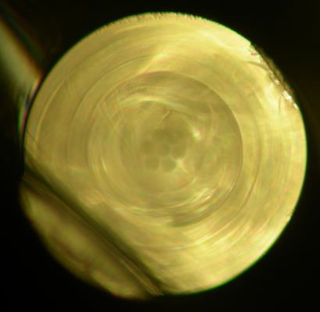
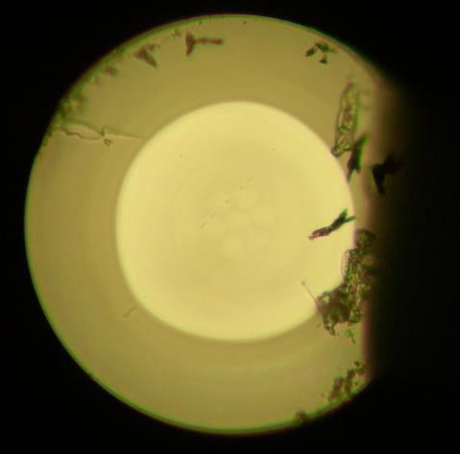
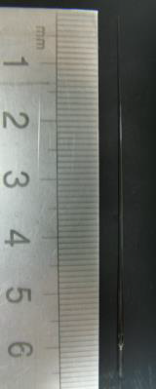
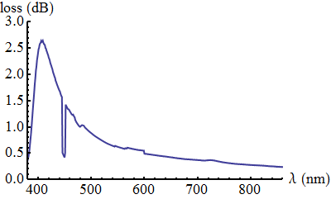
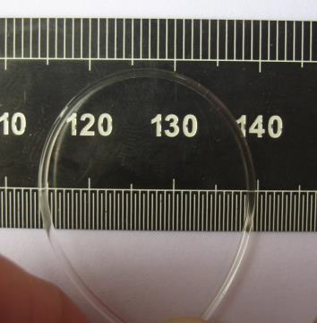
V<0.5um
~ 310um
~ 1 mm
~ 55 um
~ 560 um
Photonics for planets

Slide 12
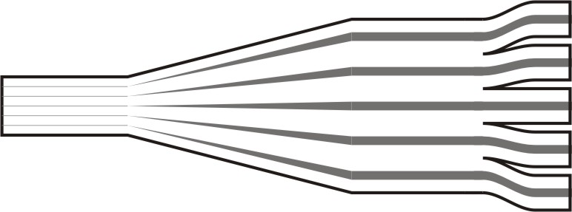
What is a photonic lantern?
low-loss interface between multimode and single-mode waveguides:
1× MM core with N modes
N × SM cores
mode-number matching:
MM modes = SM cores
output distribution of light is unimportant
SG Leon-Saval et al, Opt Lett 30 (2005) 2545
Photonics for planets

Slide 13
Reciprocal device
low-loss interface between single-mode and multimode waveguides:
1× MM core with N modes
N× SM cores
mode-number matching:
MM modes = SM cores
output distribution of light is unimportant
SG Leon-Saval et al, Opt Lett 30 (2005) 2545
Photonics for planets

Slide 14
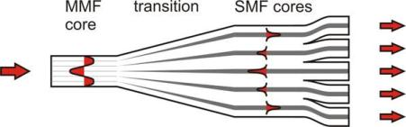
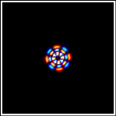
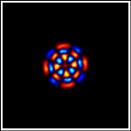
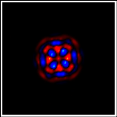
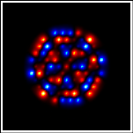
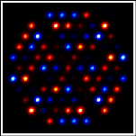
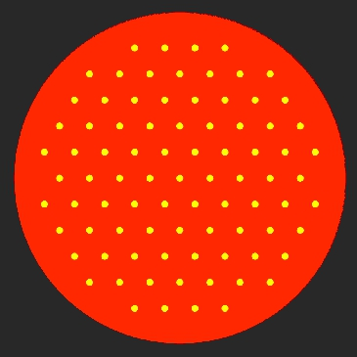

Taper transition
mode 42
mode 42
mode of MM core
→ adiabatic →
supermode of coupled SM cores
independent SM cores
TA Birks et al, Opt Express 20 (2012) 13996
Photonics for planets

Slide 15
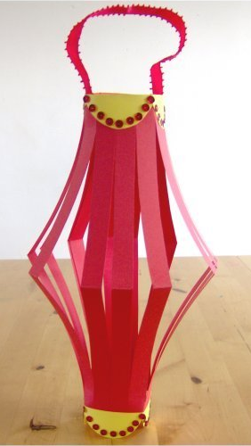
Propagation between two lanterns
ideal case:
mode of MM core
supermode of coupled SM cores
independent SM cores
identical paths
phases preserved
same supermode
same mode
Photonics for planets

Slide 16

Propagation between two lanterns
realistic case:
mode of MM core
supermode of coupled SM cores
independent SM cores
perturbed paths
phases scrambled
several supermodes
severalmodes
mode spectrum: scrambled, uniformly filled, insensitive to input
losses: MM transmission line with SM performance
N$≈\frac{V^{2}}{4}$=$\frac{π^{2}d^{2}{NA}^{2}}{4λ^{2}}$
mode-number matching
TA Birks et al, Opt Express 20 (2012) 13996
Photonics for planets
Notes:
Fixed FRD

Slide 17
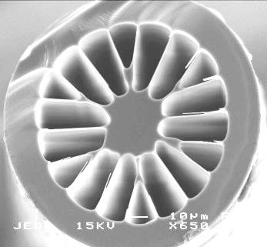
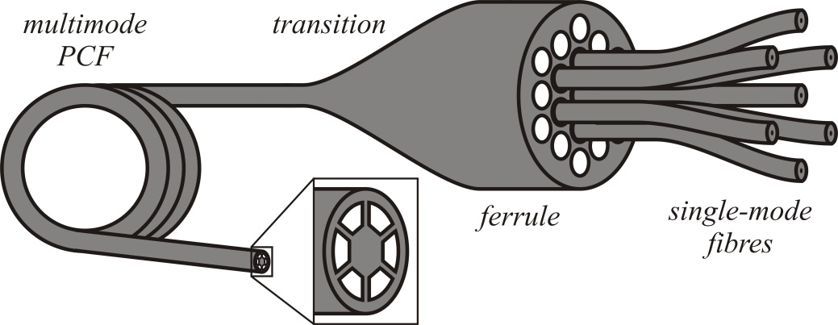
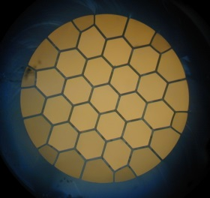
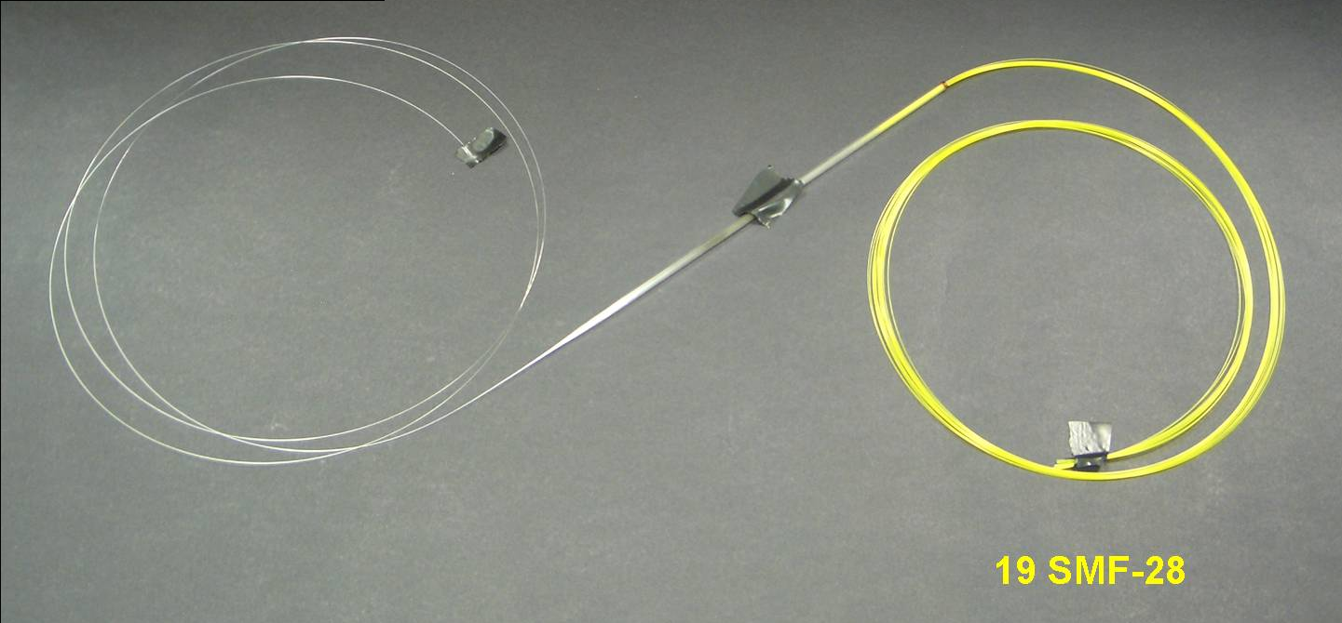
Photonic lanterns, Type 1
SMFs tapered in a photonic crystal fibre template
MMF
19 SMFs
145 µm
~4 mm
MMF
transition
19× SMF
SG Leon-Saval et al, Opt Lett 30 (2005) 2545
Photonics for planets

Slide 18
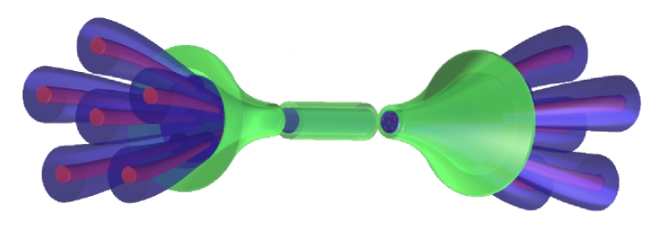
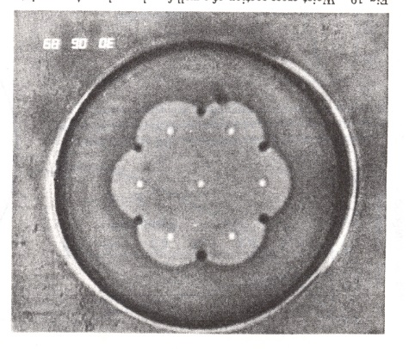
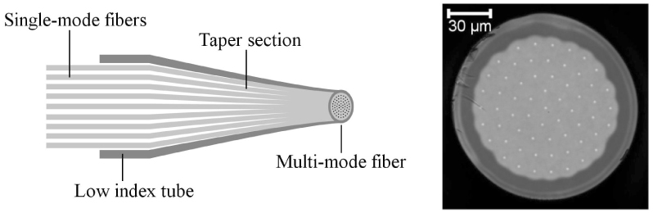
Photonic lanterns, Type 2
SMFs tapered in a low-index glass capillary
NK Fontaine, OFC (2013) OTh1B.3
DB Mortimore et al, Appl Opt 30 (1991) 650
N = 61 SMFs
0.76 dB loss
D Noordegraaf et al, Opt Express 17 (2009) 1988
D Noordegraaf et al, Opt Express 18 (2010) 4673
Photonics for planets

Slide 19
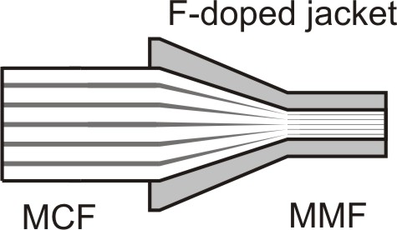
Photonic lanterns, Type 3
multicore fibre tapered in a low-index glass capillary
F-doped silica capillary
MCF
oxy-butane flame
loss < 0.5 dB
TA Birks et al, Opt Express 20 (2012) 13996
Photonics for planets

Slide 20
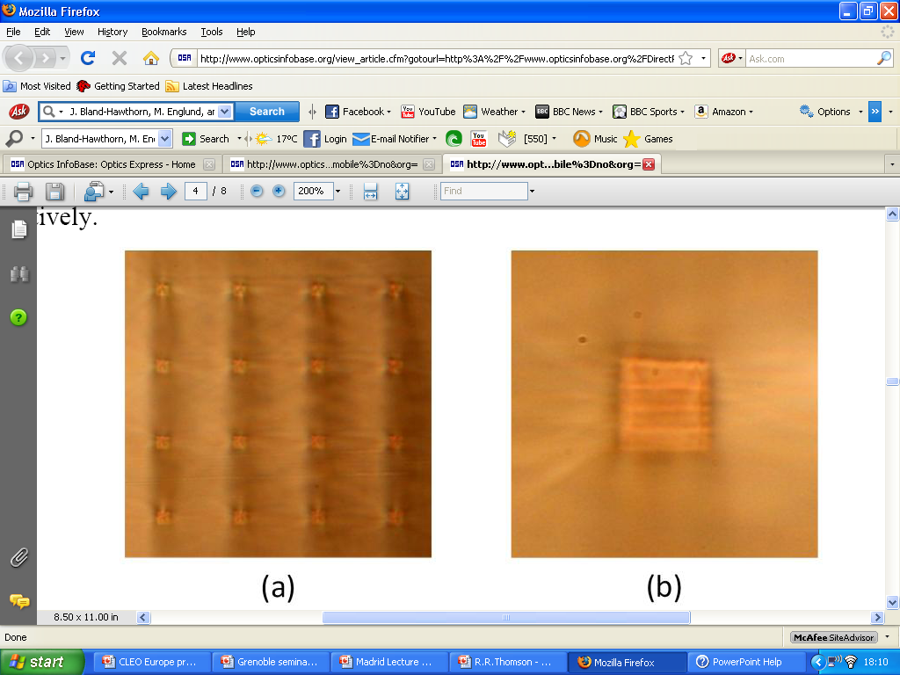
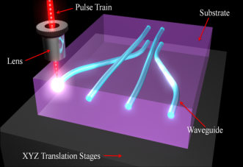
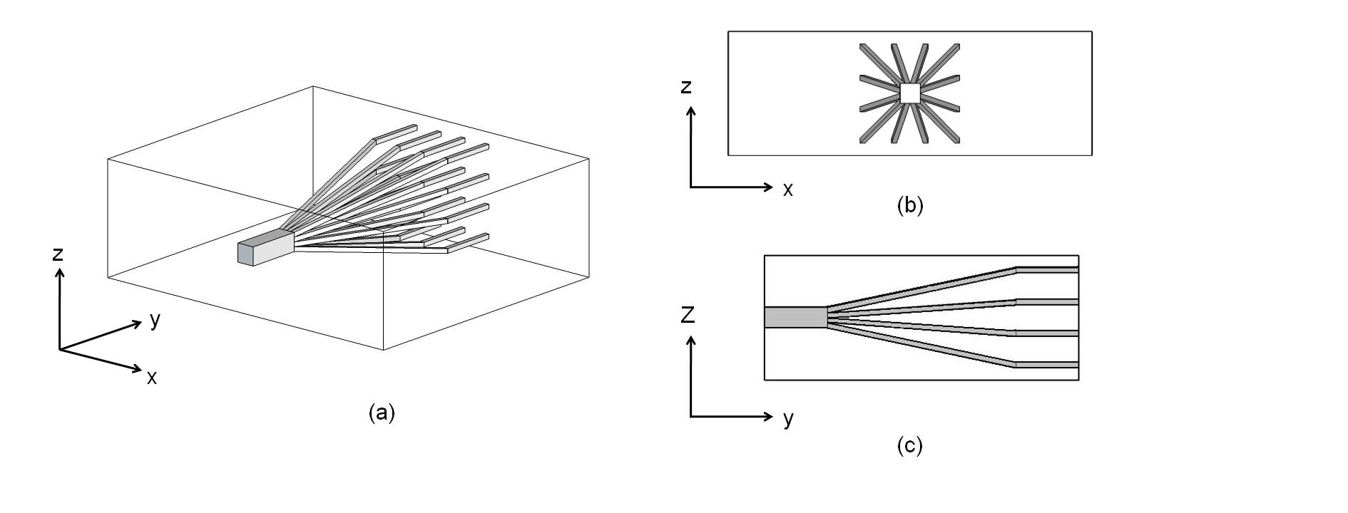
Photonic lanterns, Type 4
integrated optics, eg ultrafast laser inscription
RR Thomson et al, Opt Express 19 (2011) 5698
I Spaleniak et al, Opt Lett 21 (2013) 27197
Photonics for planets

Slide 21
Tapering the jacketed MCF
fibre
oxy-butane burner
TA Birks et al, JLT 10 (1992) 432
Photonics for planets

Slide 22
Some remarks
MCF terminated with photonics lanterns act as low FRD relay with broadband operation with incoherent output intensity distribution
Potential in MM and SM interfaces:
Mode scrambler
MM spectral filtering
Photonic lantern: conversion between a multimode port and a multiport system
4 existing lantern technologies
Photonics for planets

Slide 23
Spare slides
Photonics for planets

Slide 24

Adjusting the geometry
are they the right N modes?
MM core
good array geometry
bad array geometry
NK Fontaine et al, Opt Express 20 (2012) 27123
SG Leon-Saval et al, Nanophotonics 2 (2013) 429
Photonics for planets

Slide 25
Vacuum and pressure lines
Preform feed
V_{feed}
Furnace
Hot zone
Diameter monitor
Coating cup
UV lamp
V_{draw}
Capstan
Take-up
Photonics for planets
Notes:
Mention the parts names

Slide 26
PCF and multicore fibre fabrication
Stack and draw
Photonics for planets

