Slide 1
Multicore fibres for precision radial-velocity applications
Dionne Haynes
Photonics for Planets Nov 2014

Slide 2


In collaboration with Itan Gris-Sanchez
and Tim Birks at the University of Bath

Slide 3
Multicore Fibres and Photonic Lanterns
Enable efficient coupling of “seeing limited "and partially AO corrected PSFs into
the single-mode regime
Enable photonic function in a seeing limited regime with high efficiency
i.e. photonic filters (FBGs) for OH suppression
Enable efficient implementation of diffraction limited spectrographs
Break the dependence of instrument size on telescope diameter as the entrance
slit of the spectrograph becomes diffraction limited thus allowing a much more
compact system for a given resolving power
? New type of multicore fibre with photonic lanterns designed to mode
scramble and reduce modal noise i.e. amplitude and phase scrambling
Application >>>> Precision Radial Velocity Exoplanet detection.

Slide 4

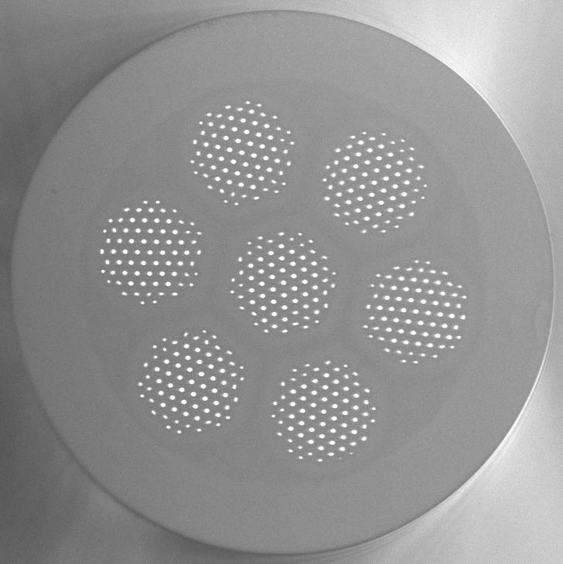
And now for something completely different

Slide 5
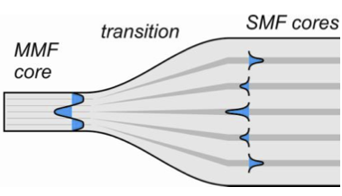
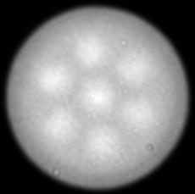
MCF for phase and amplitude scrambling
How does the photonic lantern work >>>
The lantern transforms each input MMF mode into a distinctive pattern of amplitudes and phases across the MCF cores - i.e. a supermode
transition
single cores
transition
MM core
MM core
~3 meters in length
In a perfectly straight MCF with identical cores, these amplitude and phase relationships are preserved, so entering the output lantern we still have that same supermode. The reverse of the input lantern, and the original input mode is restored in the output MMF as in the MCF FBG devices
To get mode scrambling, we deliberately do not preserve the phases between the MCF cores.

Slide 6
MCF for phase and amplitude scrambling
If the cores are uncoupled, we can do this simply by making their optical lengths different. By making the cores dissimilar, and/or bending the fibre. This couples light pseudo-randomly between the supermodes, and hence between the modes of the output MMF. Vibrating the fibre adds extra randomisation and time-averaging to the process.
MCF consists of 511 individual cores
designed to operate over a broadband
visible wavelength range 380-860nm
has dissimilar cores to provide the path
length differences
some of the cores are 2 and 3 moded at
the shorter wavelengths to persevere
mode number (low loss)

Slide 7
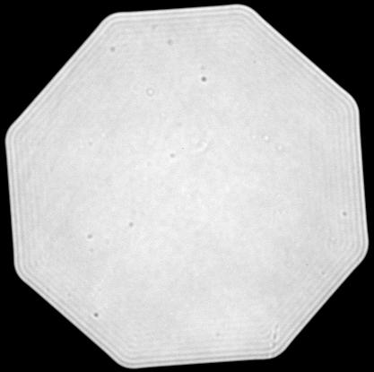
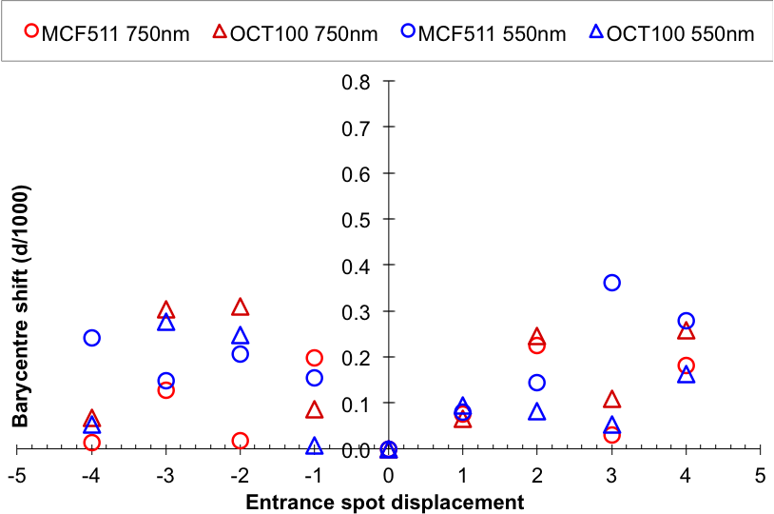
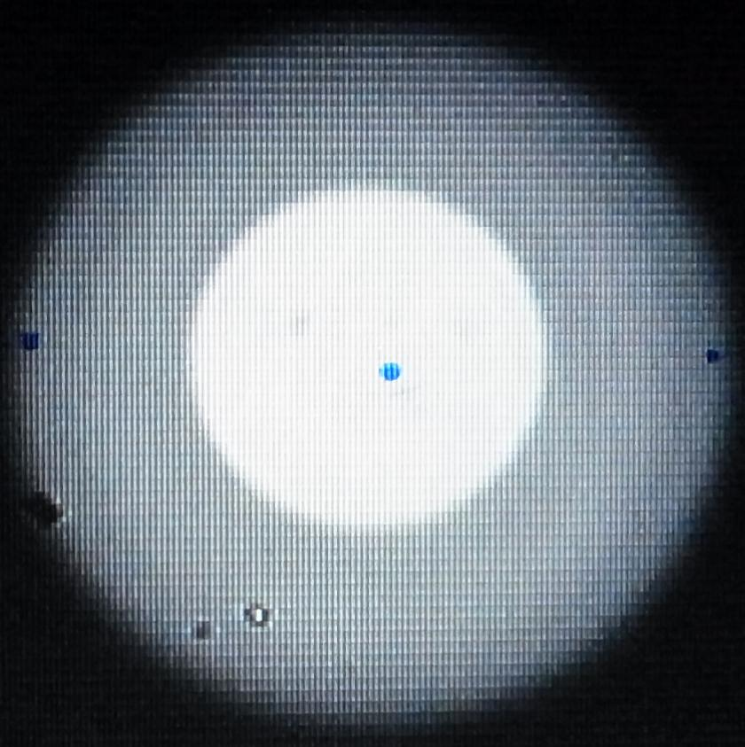
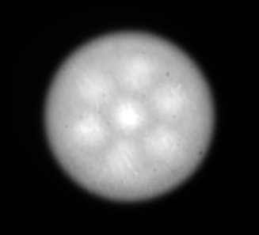
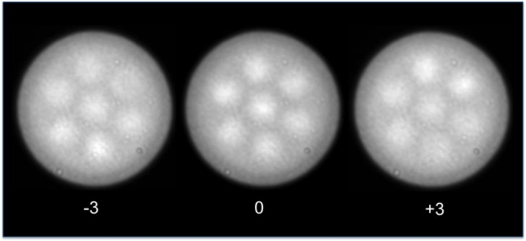
Near Field results – incoherent light
Barycentre shift in the spectral direction
Octagonal 100 μm
Input
d
MCF 55 μm
Output

Slide 8
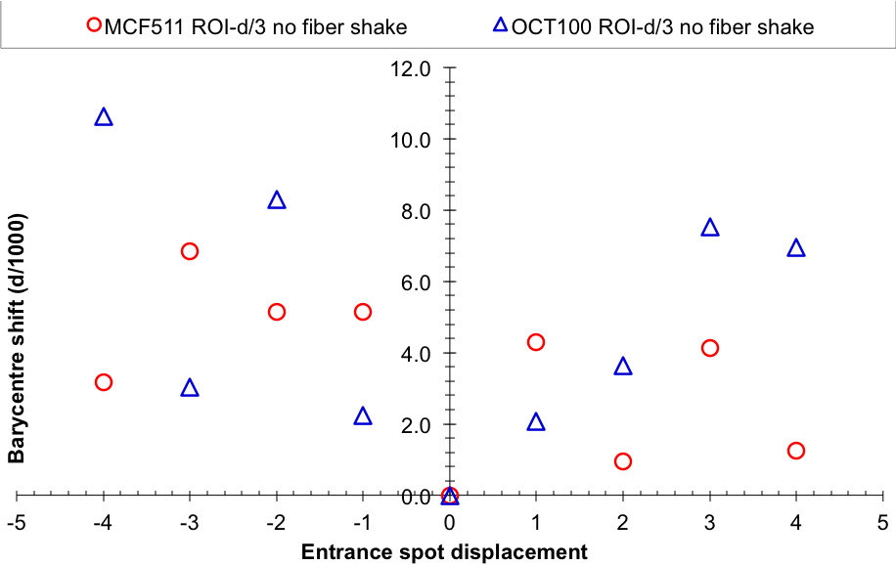
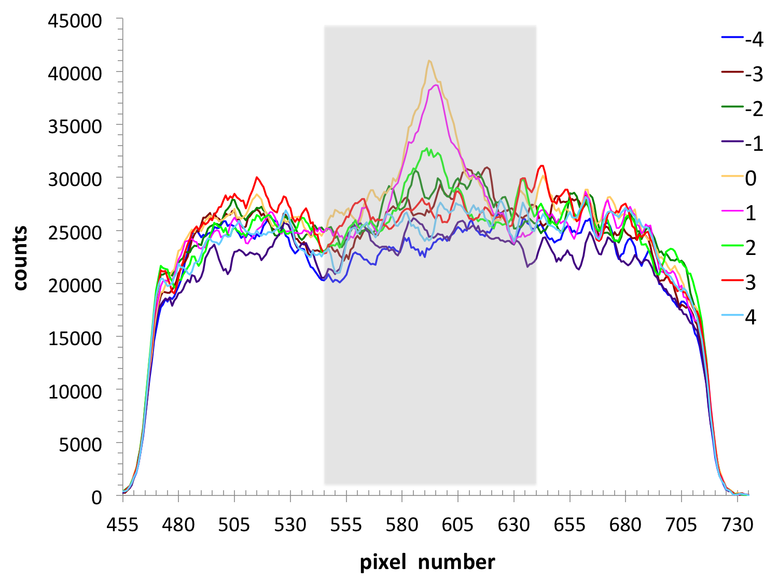
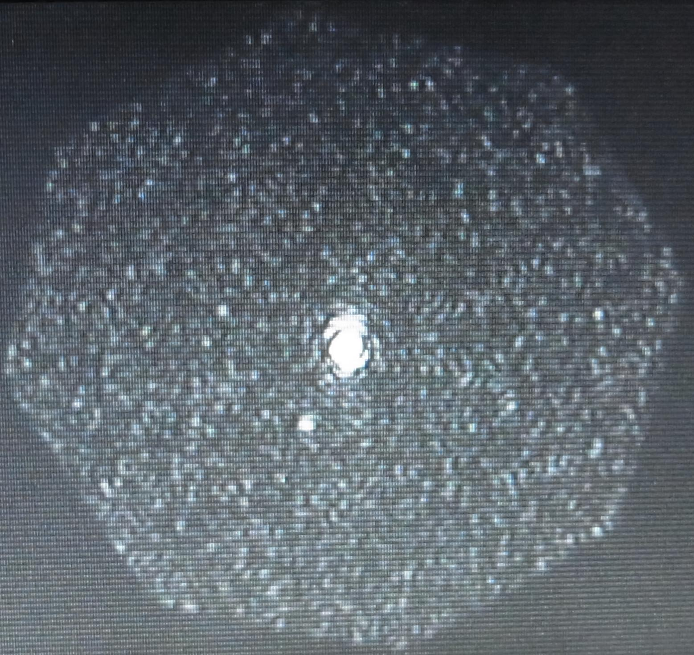
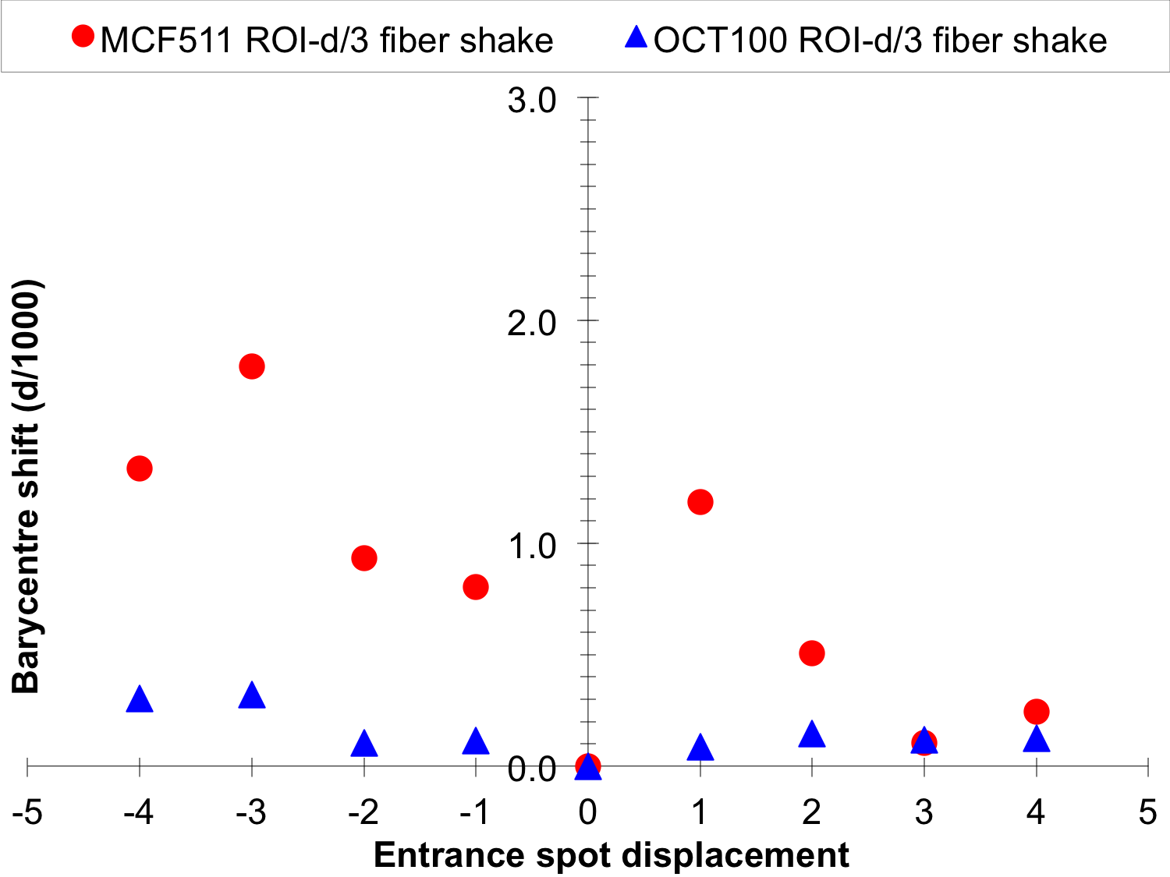
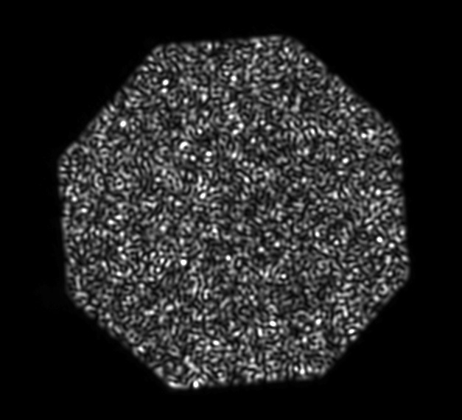
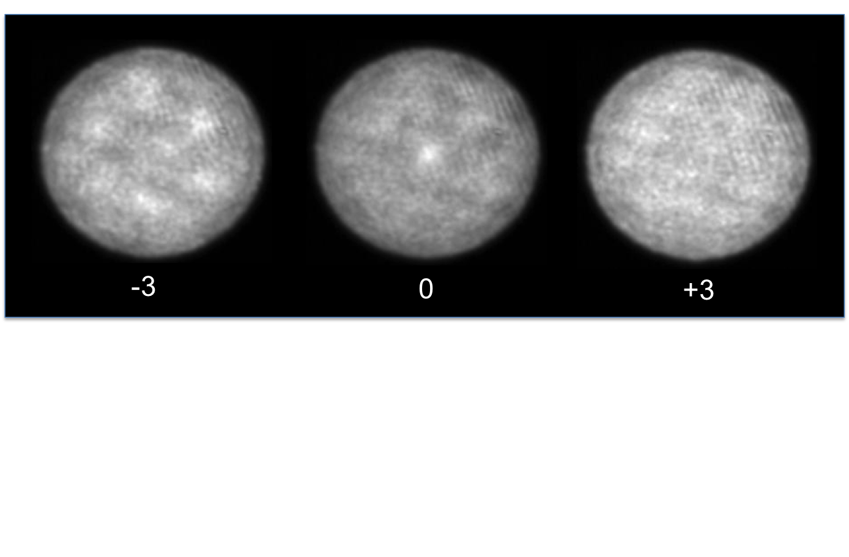
Near Field results – coherent light
Barycentre shift in the spectral direction
Input
d/3
Output

Slide 9
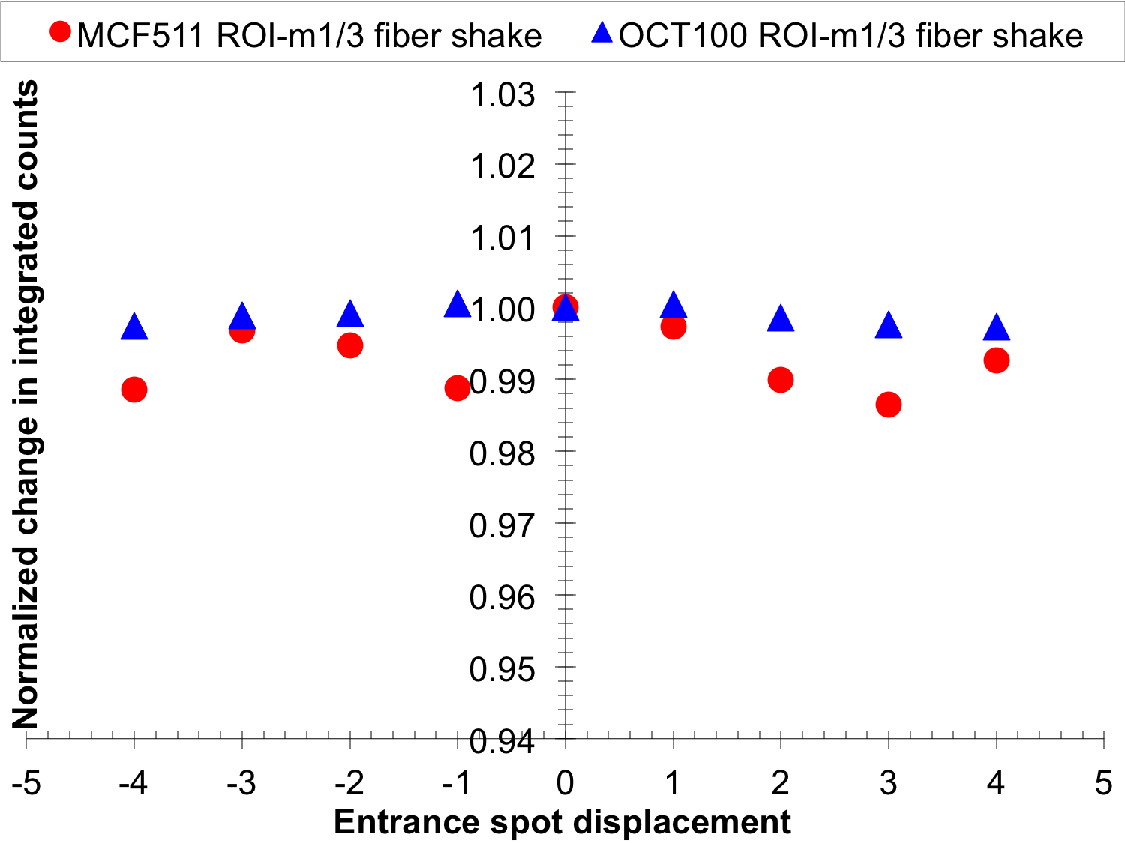
Near Field results – coherent light
Modal noise – photometric stability

Slide 10
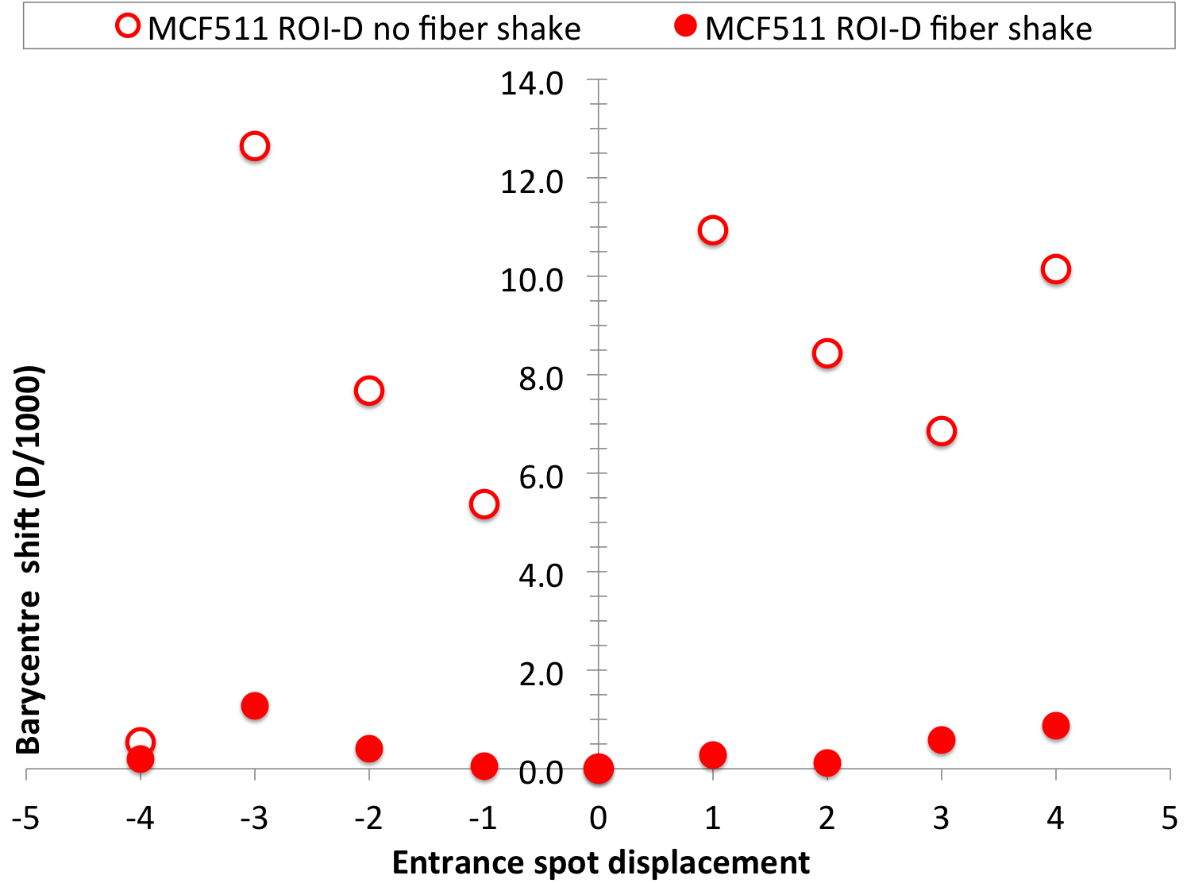
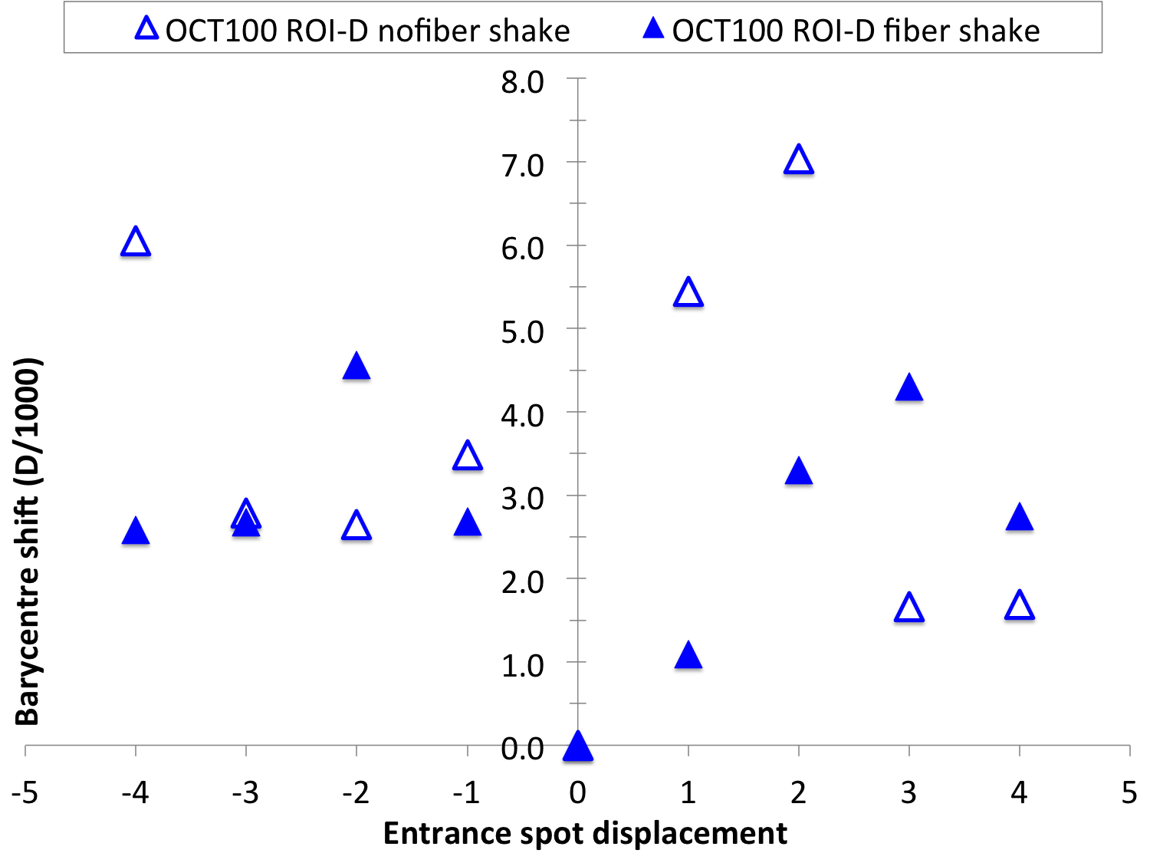
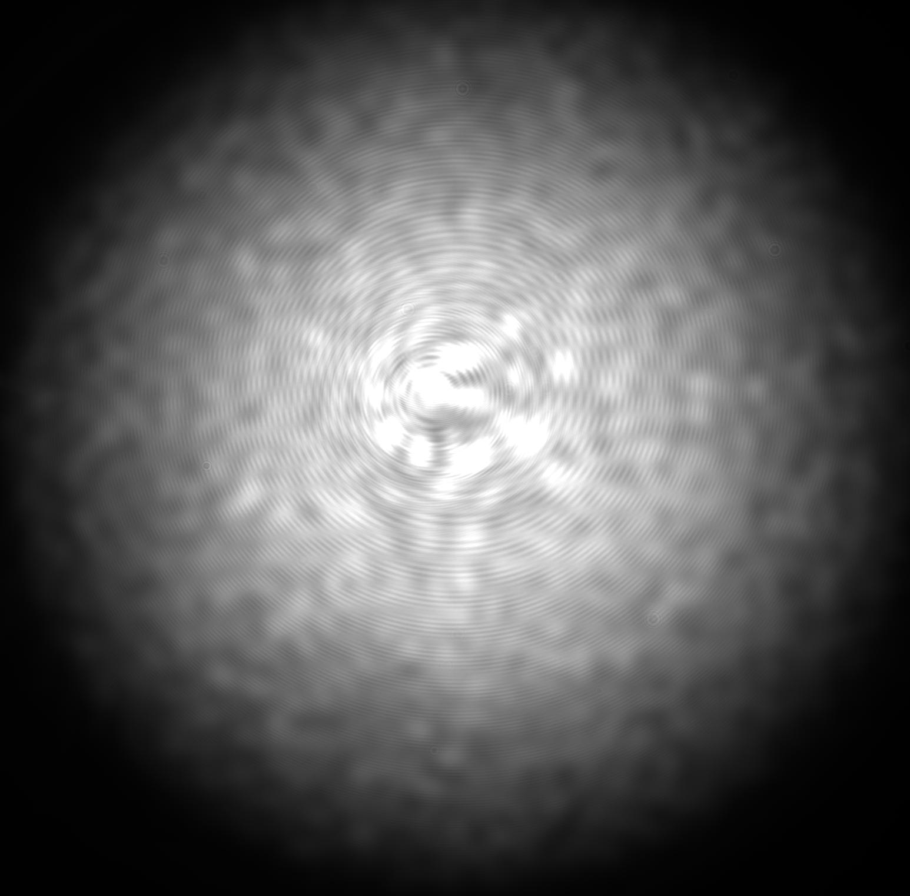
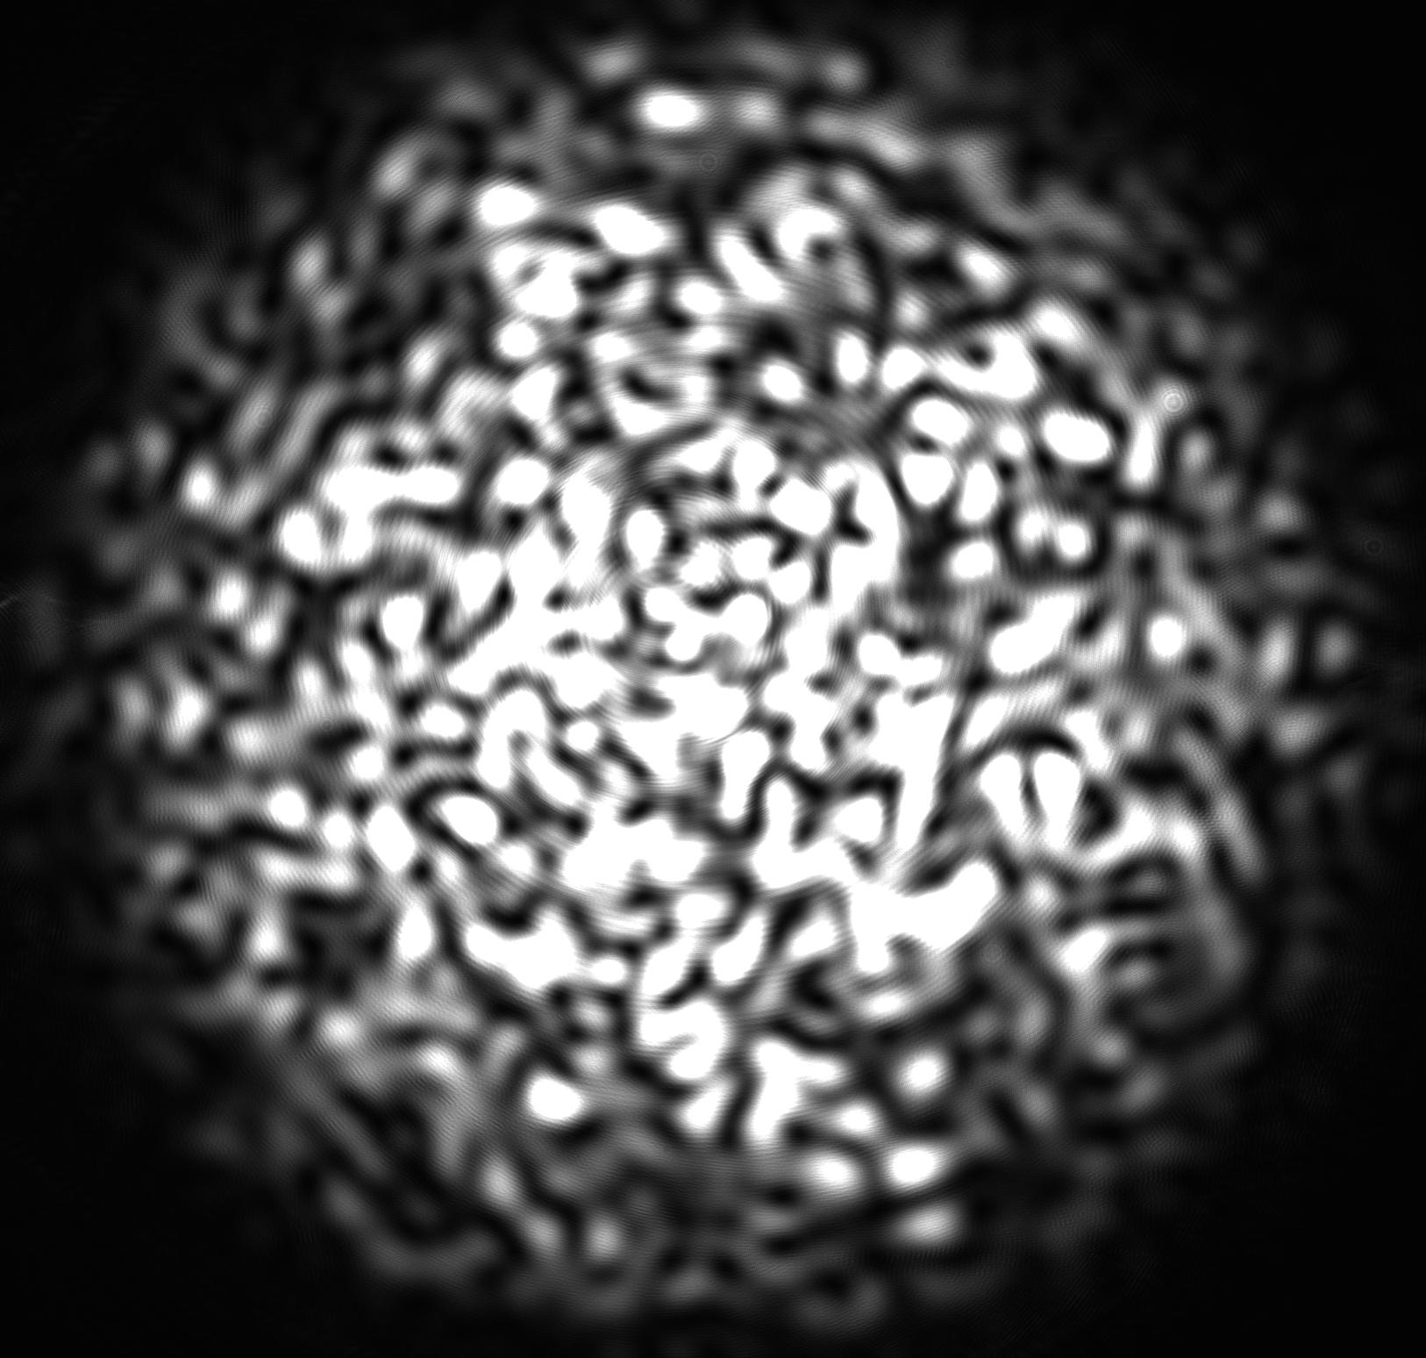
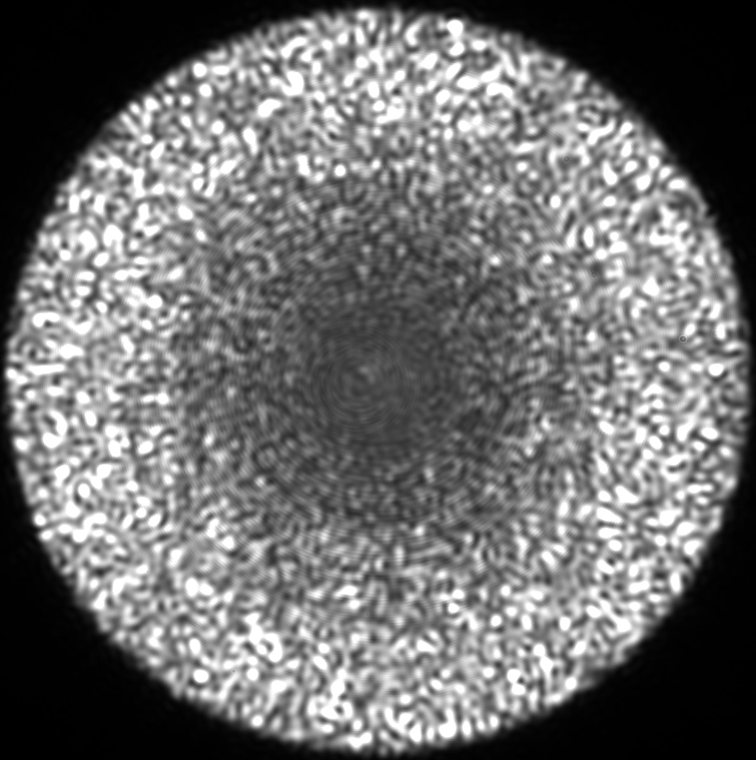
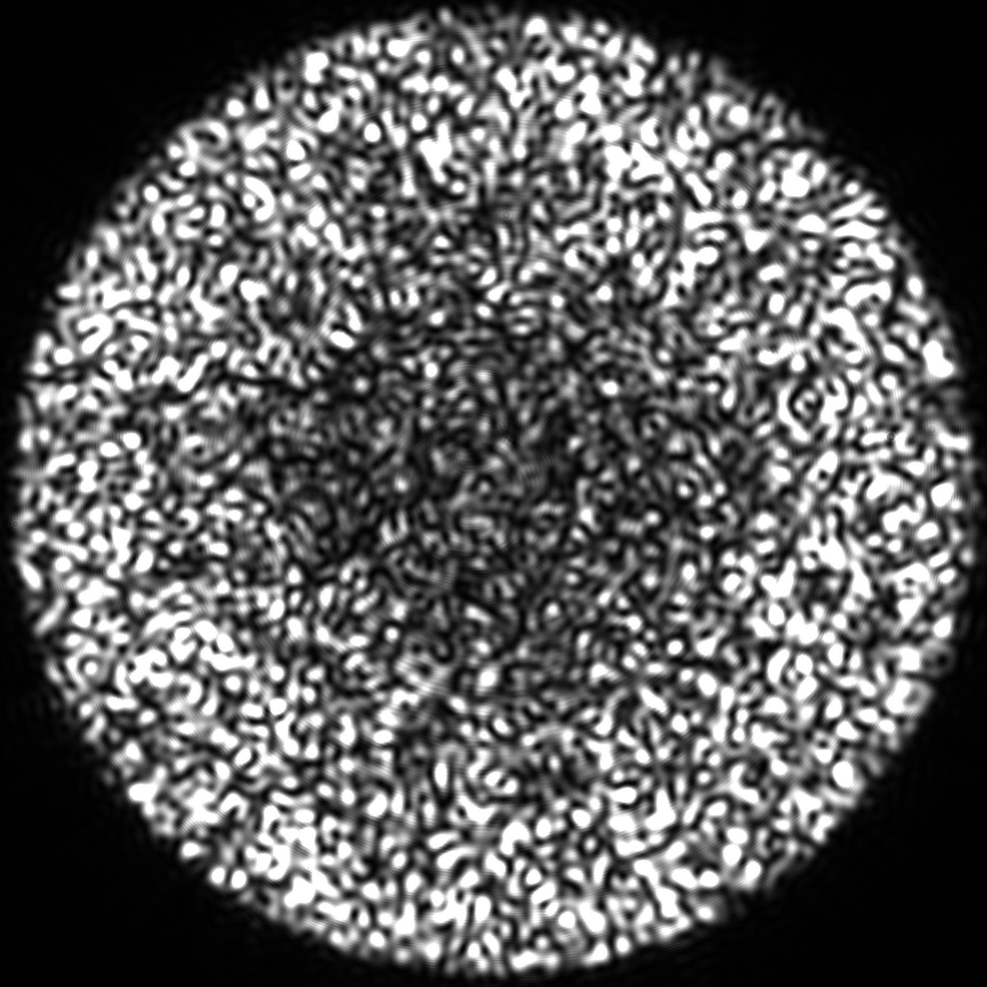
Far Field results – coherent light
Barycentre shift in the spectral direction

Slide 11
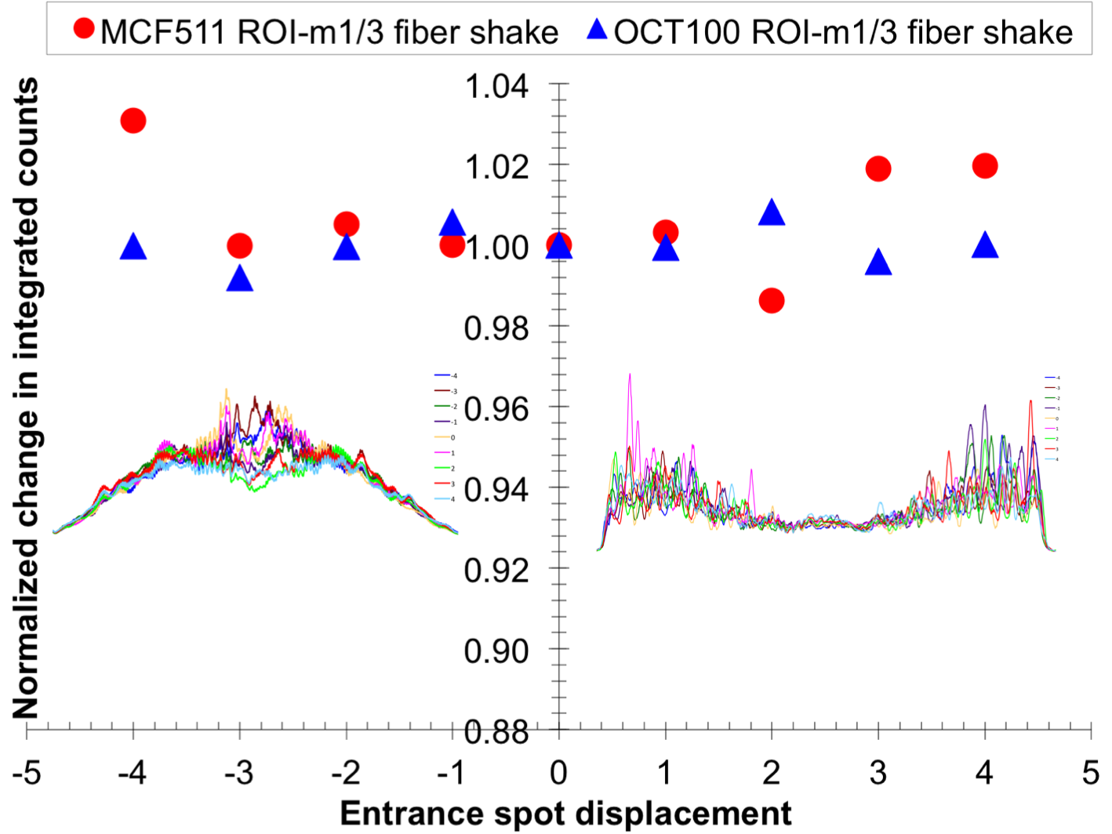
Far Field results – coherent light
Modal noise – photometric stability

Slide 12
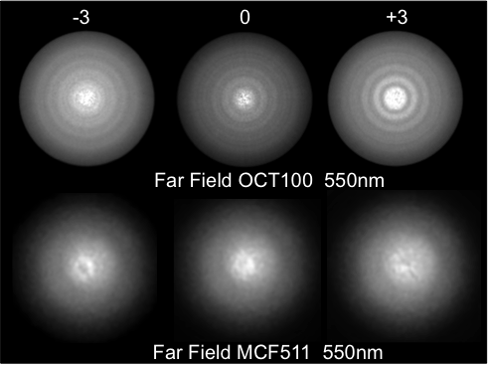
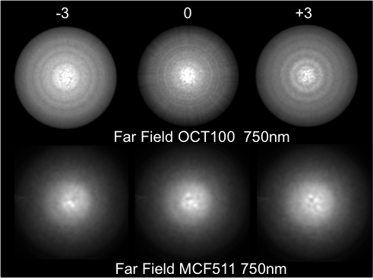
Far Field results – incoherent light
Far field patters for entrance spot displacements. Input spot incoherent light, diameter 25μm.

Slide 13
Transmission
FBP fibre
MCF fibre
CURRENTLY
Photonic lanterns < 0.5db
Approximation at 550nm
3 meter device ~78%
10 meter device ~73%

Slide 14
Summary
The multicore fiber shows equivalent scrambling and modal noise performance to the octagonal fiber
Further improvements of the MCF are anticipated once the residual core structure has been reduced
-Splice short section of MMF on ends of MCF PL
-Create dopant diffusion by heating end of MCF PL
Any movement of the fibre, bending, shaking improves both phase and amplitude scrambling without inducing FRD (PL fixed NA)

Slide 15
Summary
Aim to generate a stable Gaussian near field and far field pattern i.e Gaussian profile at image plane and pupil plane
(“the far field that illuminates the spectrograph grating and much of its optics, and therefore a stable Gaussian profile is desired to achieve low scattering and minimal aberration effects” - Simon Ellis et al. SPIE 2014)
Could be retrofitted to existing fibre feeds at the output end
Can splice MMF tapers directly to MM port of PL to perform beam conversion

Slide 16
Future
We would like to perform an on-sky test using a high resolution fibre feed spectrograph
Compare Current state of the art octagonal fibre and double scramblers to MCF
Develop an IR scrambling fibre
-RV science in IR
-Phase and amplitude scrambling for OH suppression
MCF FBG instruments

Slide 17
Acknowledgements
Itan Gris-Sanchez and Tim Birks
Katjana Erhlich and Roger Haynes

